Slide 1

State of CX in Canada
2020

Slide 2



Speakers
John Bardawill
Sam Fiorino

Slide 3


Background
LATE
Inaugural study to assess the CX landscape in Canada
2018
EARLY
Follow up study to find out what changes, if any, happened in the Canadian CX
2020
SUMMER
1-on-1 interviews with senior leaders from various industries on CX and COVID-19 effect on it
2020

Slide 4






Methodology
2020 Studies
FEB – MAR 2020
JUN – JUL 2020
Quantitative Research
Qualitative Research
83 Organizations
1-on-1 Interviews
1000 Customers
XX Senior Leaders
ACROSS CANADA

Slide 5


Engaged employees…
operating effective and efficient processes…
with sound enabling technology…
results in engaged customers…
who provide the company’s financial results
– Roy Barnes and Bob Kelleher
Notes:
Customer Experience Can’t Be Done is a Silo

Slide 6
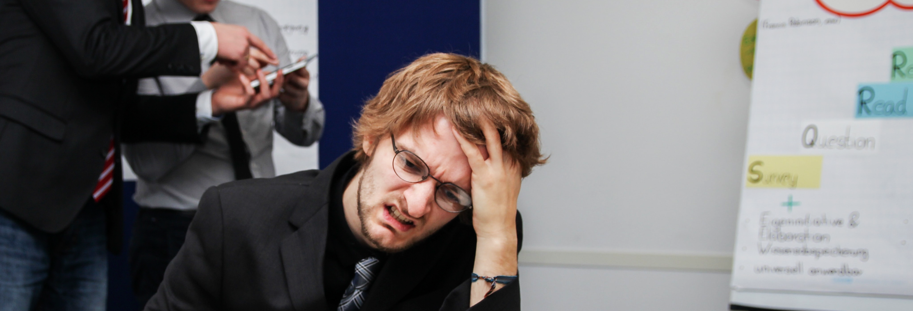
CX in 2020
CX is too hard; why?
Some companies are failing; why?
What do successful companies focus on?
COVID-19; now what?

Slide 7
CX is Too Hard; Why?
47%
31%
2018: Alignment is seen as the Top barrier
2020: CX is Complex
25%
25%
Alignment
21%
Conflicting priorities*
25%
CX understanding
14%
Lack of urgency
22%
Other goals*
14%
Culture
21%
Technology
Being internally siloed
12%
18%
Consistency
Process Complexity
11%
18%
Cost
Alignment
9%
Process Complexity
Ownership
13%
9%
Lack of resources
Technology level
13%
9%
Culture
Lack of resources
11%
Turnover
8%
Cost
VOC
6%
Complacency
* “Other goals” in 2018 and “Conflicting priorities” in 2020 are the same

Slide 8

Some Companies are Failing; Why?
Yes
Somewhat
No
Few Have a Long-Term Customer Experience Plan (2020)
49%
45%
45%
29%
29%
27%
23%
22%
21%
CX Intent Statement
Goals Tied to CX
3 Year CX Plan
CX Alignment levels by answer:
(0 - 10 scale, average is 7.6)
7.95
6.89
4.83
8.00
6.60
5.00
7.50
6.95
5.97

Slide 9

What are Successful Companies Focused on?
Continuous, ongoing improvement vs. “projects”
Employee experience, from hiring to development to growth
Attaching incentives/bonuses to CX performance
Personalization and segmentation
High focus on Voice of the Customer
Long-term customer needs over short-term profits/margins

Slide 10
It is like personal fitness:
a lot of ingredients are needed
to make real progress.
And long-term dedication is critical.
Notes:
Customer Experience Can’t Be Done is a Silo

Slide 11


Importance of Accessibility: Customers are Getting More Sophisticated In Their Understanding of Good CX
Top Rated Factors
Bottom Rated Factors
2018
2020
2018
2020
Hours of operation
Got what you needed
Met your needs
Friendly Staff
Hours of operation
Timely responses
Readily accessible info
Got what you needed
Pleasantly surprised
Went the extra mile
Felt valued
Quality of service
Helpful staff
Went the extra mile
Pleasantly surprised
Felt valued

Slide 12



What does COVID-19 Mean to This?
A Phase 5 study of consumers showed the majority scored providers of financial services (banks, investment, insurance providers) at least 8 out of 10 with that FI’s response to COVID-19
Areas of success:
Make it easy for me to get a hold of you, do my business, digital access
What could be better:
Proactive communications
A consumer who is happy with the proactive communications provided by a service provider is more than twice as likely to report that their level of trust has grown with that provider

Slide 13


Thank you
Please send questions or comments to:
Stephan Sigaud
(647) 207-4468
stephans@phase-5.com
John Bardawill
(416) 880-3206
jbardawill@tmginternationalinc.com

