Slide 1


Driving a Customer Centric Culture from the Outside In
Tanya Fowler, Head of CX
FCT
CRIC WEBINAR

Slide 2
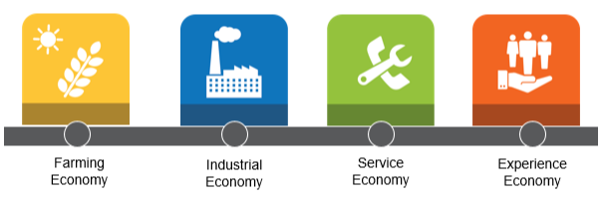
Driving a Customer Centric Culture from the Outside In
Why? The evolution and continued growth of CX…
“The last best experience that anyone has anywhere, becomes the minimum expectation for the experience they want everywhere.”
–
Bridget van Kranlingen, IBM

Slide 3
Driving a Customer Centric Culture from the Outside In
What? Take the Journey - together
01
06
Unify – from the Outside In
Strategy + Organizational Focus
Start at the top!
Break down silos by uniting customers + employees
Tackle the hard stuff!
02
05
Education
Start at the top!
Every employee’s role is critical
Research, Research!
Co-create foundational artifacts
Connect research tools to every role and initiative
03
06
Set the Stage
Define your customer
Give them the spotlight!
Ideate, Build + Celebrate

Slide 4
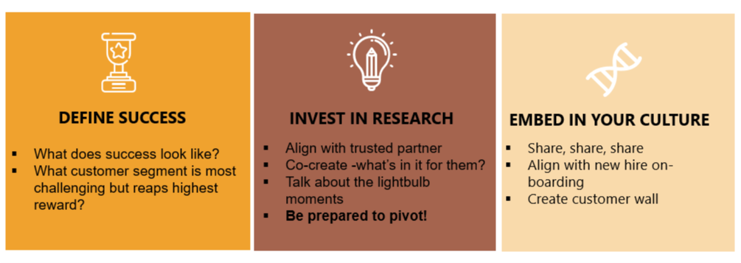
Driving a Customer Centric Culture
How?
Partnered with Phase5 to co-create customer journey and empathy map of high impact, high visibility customer segment
Defined and validated key customer persona
Delivered foundational tools to allow employees to step into the customers shoes
Key Learnings

Slide 5
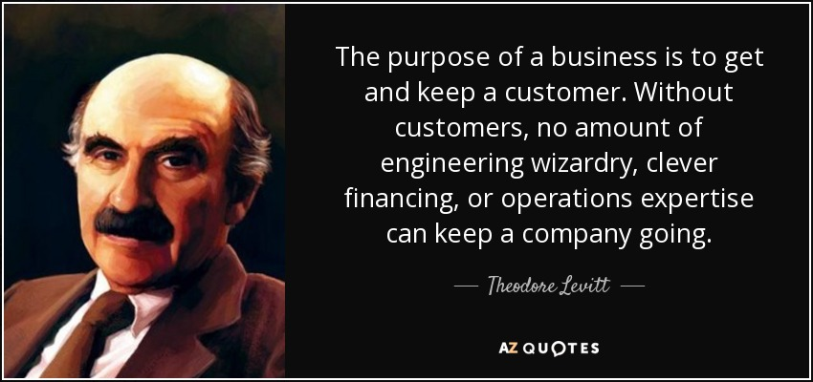
Driving a Customer Centric Culture
Why?
It’s about customer perceptions, not brand intentions. Perceptions often differ from what a company claims in marketing messages, product specifications, service contracts, and elsewhere.
Journeys reflect customers’ behaviors, not just companies’ hopes. Journeys often diverge from planned business processes because people change their minds, backtrack, and understand or use touchpoints differently than companies expect. These divergences can reveal pain points or emerging needs, which are key signals for improving CX.

Slide 6



Thank
You!
Tanya Fowler, CCXP
Head of CX
Andreas Noe
Partner
@tan_fowl
@_Phase5

