Slide 1

Top Banking Needs of
American Small Business Owners During & After the Pandemic
August 2020

Slide 2

Welcome
Steve Mast
President & Chief Innovation Officer,
Delvinia

Slide 3




Laura Craig
VP, Client Success
Steve Hansen
Partner

Slide 4

Ask your Questions!
Stephan Sigaud
EVP, Marketing & Development,
Phase 5

Slide 5

Webinar Overview
1
Why we did this study
2
How we did the research
3
How customer centric are US banks when it comes to small business?
4
Where are US banks doing well? Where are the gaps and opportunities?
5
What are the key experience drivers banks need to focus on?
6
Take-aways
7
Q&A

Slide 6

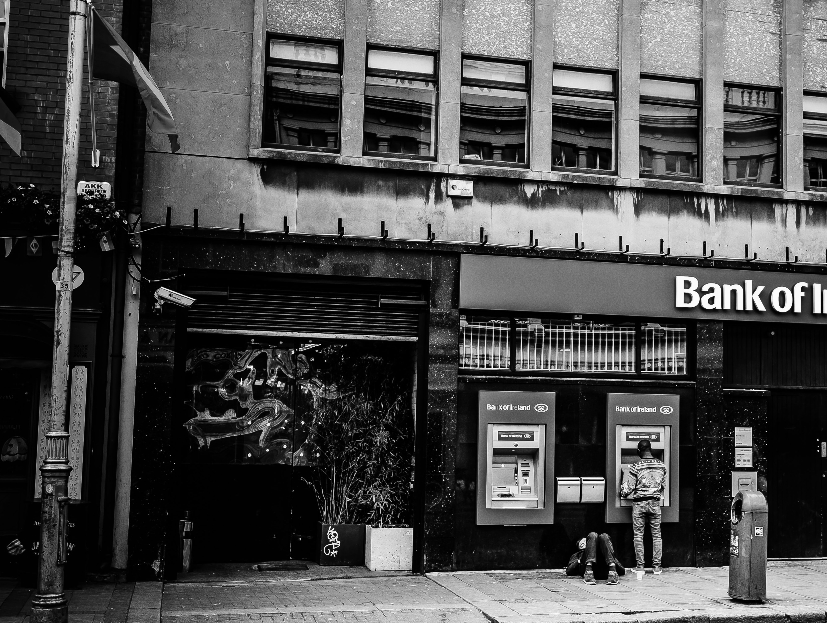

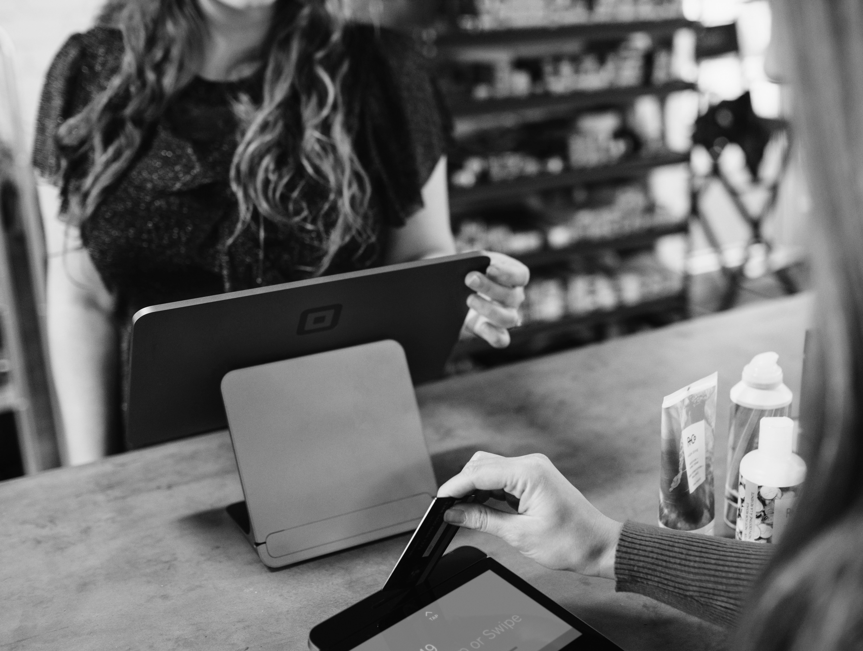
Why we did this study
1. Understand how small businesses perceive their banks on the key pillars of innovation, digital, & customer experience
2. Determine what dimensions of the overall experience are most important
3. Identify opportunities for banks to be more customer centric with their small business customers

Slide 7


How we did the research
Online survey of 650 small business owners (SBOs) in Canada and the U.S. in December 2019.
Participants were sourced through Delvinia’s AskingCanadians and AskingAmericans panels.
Mix of business sizes, sectors and location.
Distribution by country
CANADA
US
Number of employees
CANADA
US
71%
61%
13%
13%
11%
16%
11%
5%
Sole proprietor
/ Trader
2- 9
employees
10 – 24 employees
25 – 49
employees

Slide 8
Innovative Research Design
Seamless 25 minute experience for respondents
Including qualitative with all participants
Quantitative
Survey
Screening, bank
usage for personal & business, experiences and attitudes
Qualitative
Chat
Text-based, one-on-one interviews with AI enabled virtual moderator CRIS
Final
Demos
Size of business, Vertical
1
2
3

Slide 9
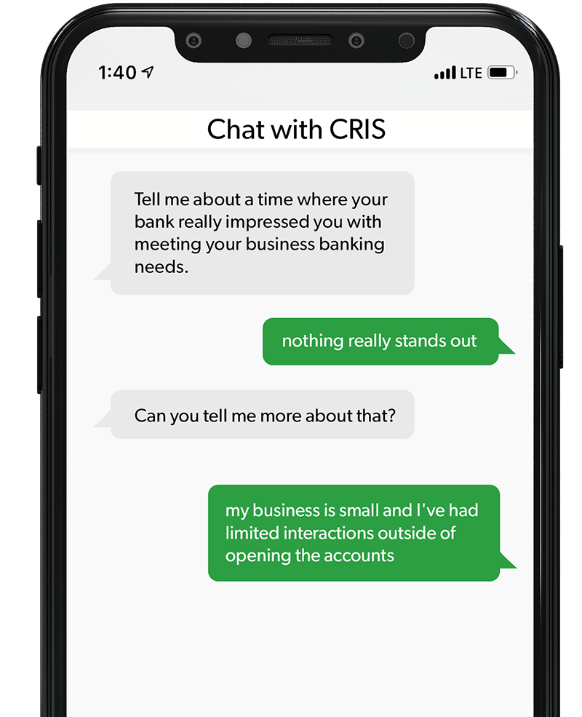
What is CRIS?
CRIS by Delvinia is a virtual moderator that conducts one-on-one text based qualitative interviews at scale.
Participants can answer research questions on the device of their choice, at a time that is most convenient for them.

Slide 10




Overall, US banks are doing a decent job at customer centricity… but there is room for improvement
Key Customer Experience Metrics
Mean Score
8.4
Mean Score
8.3
60%
58%
Top 2B
Top 2B
Mean Score
3.9
15%
Top 2B
Overall
Satisfaction
Likelihood to Recommend
Likelihood to
Switch

Slide 11

Innovation performance is strong, but insufficiently differentiated
Top Two
54%
53%
SBOs feel that their FIs offer solid products and services, but opportunity to differentiate still remains.
50%
47%
41%
6 or below
21%
17%
21%
25%
29%
Overall
business banking innovation
Offers technological solutions to better meet banking needs
Offers innovative digital tools to help me manage my business's finances
Helps me stay on top of industry trends
Offers banking solutions that are different from what I can get at other banks

Slide 12

User experience – relative satisfaction, with opportunities
Top Two
65%
SBOs are relatively satisfied with their banks’ digital offerings, but there may be opportunities to improve new product setup and visual appeal.
As digital channels have become more important in 2020, banks should ensure their digital setup can serve even less digitally-savvy small businesses.
63%
60%
59%
60%
56%
56%
Overall
online
banking experience
Overall
mobile
banking experience
Ability to manage
all your
business banking
using digital channels
Time it
takes to accomplish what you set out to do on digital
channels
Ability to fully accomplish what you
set out to
do using
digital
channels
Visual
appeal of
digital
channels (mobile, laptop, desktop)
Ease of
setting up new products / services
with the
bank

Slide 13

Customer Service – relevant communications with SBO goals in mind
Top Two
65%
SBOs are pretty happy with customer service, but is there opportunity for improvement?
Throw out the cookie cutter. Banks that approach business customers with relevant communications focused on the SBO’s own goals may be able to pull away from the crowd.
62%
60%
59%
58%
56%
56%
54%
6 or below
12%
14%
12%
15%
18%
13%
17%
18%
Overall customer service experience
Meets
my expectations
Friendliness
of the
banking
staff
Makes me
feel valued
as a
customer
Helps me achieve
my
goals
Speed of response
call
center
customer service reps
Acts in
my best
interest
Provides proactive
& relevant comm.
that keep me informed

Slide 14

What does customer service mean?
When business banking customers think about what makes their bank customer focused, it is more about the quality of their interactions with people than with products or technology, even if technology has enabled the interaction.
  Friendly, approachable, take interest in the customer’s business
  Proactive, targeted recommendations
  Issues resolved quickly (whether bank or customer error)

Slide 15


Our business is nothing special, but they know us when we walk in. When we ask about anything or they suggest a service, it fits our business
One big example, recently things got screwy with some services. They emailed continuously, keeping customers up to date on what was going on, how they were fixing it, what their expected timeline was for having things fixed, things like that

Slide 16



Keeping up with customer service
Customer service is more than being friendly and polite. Business banking customers are looking to their bank to be proactive in offering and developing services to meet their needs.
Keeping up with technology
Keeping up with products and advice
When I first opened my account they acted like they had all the technology and they were truly interested in my business but after time went by I don't feel like they are as good as they were in the beginning
It would be nice if they have more customer service people to talk to you about their different products instead of just trying to get you in the door

Slide 17

Technology as an enabler
Business customers want the reassurance that they will interact with a human when they need it. But more and more they are expecting that technology should enable them to get tasks done quickly and easily.
If we could do everything online, including creating and closing accounts, that would be great
Being able to handle almost every banking need via an app saves small business owners like me so much time which is a direct correlation to actual money for us! I'd say just keep perfecting that product
Focus on having the best app with the most ability to bank mobile. I use my banking app daily. Just keep growing and expanding on more easy high tech ways to do banking more efficiently
“”
“”
“”

Slide 18
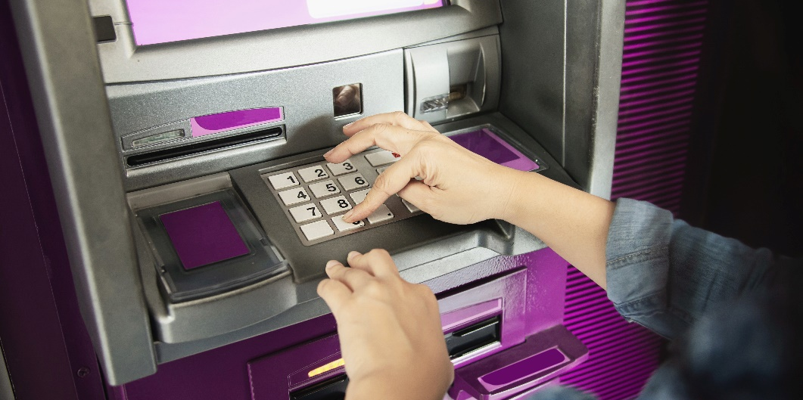

Risk in lagging technology
When technology doesn’t work, business customers may be driven to more expensive channels…
… or they may move on
I have terrible service through the unreliable ATM machines. So I avoid using any of the machines located at the branches. Very poor quality
I was supposed to sit for a 20-minute video chat to apply for a credit card. I said, never mind

Slide 19
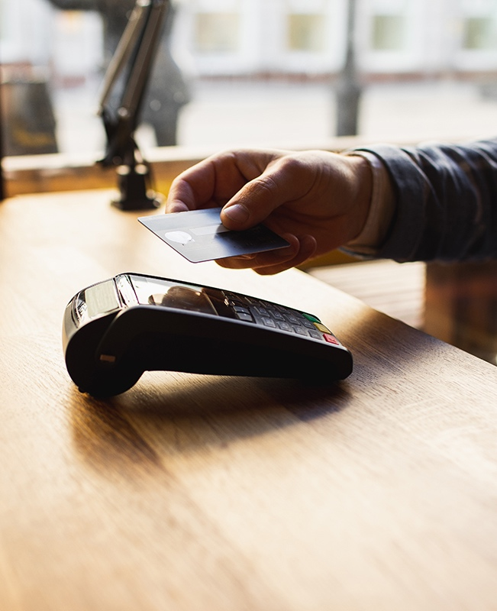
Fraud as a moment of truth
Fraud is an opportunity to demonstrate that the bank is looking out for their business customers. Banks impress with:
  Proactive contact about suspected fraud
  Measures to help the business keep going during investigation
  Efficient resolution

Slide 20
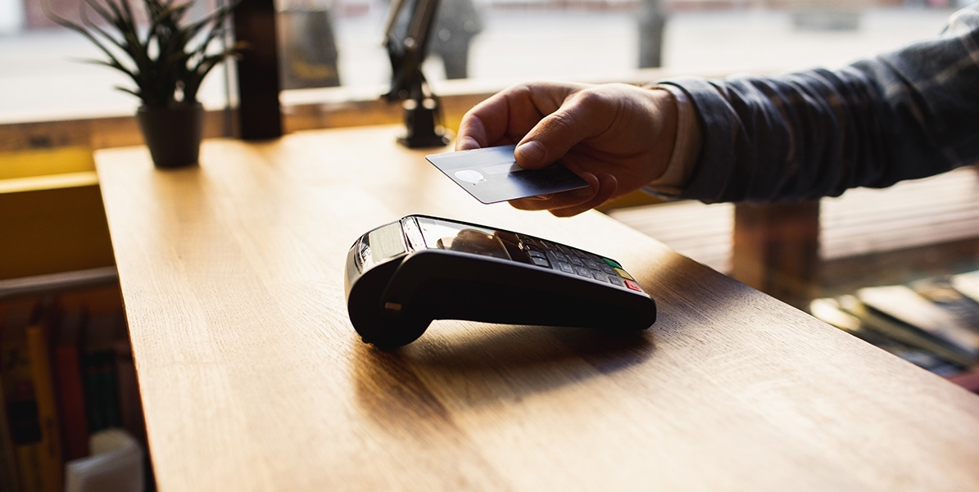

We were the victims of a cyber crime and had to call the bank on a Saturday afternoon. They had temporary funds in our account by that Monday and had the issue resolved by the end of the week
I had an issue with my business checking account. Fraudulent charges that I had no idea about. They caught it and contacted me personally and fixed the issue right away, stopping the charges

Slide 21
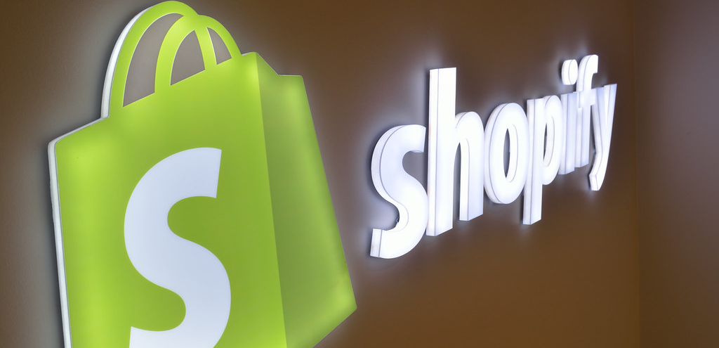
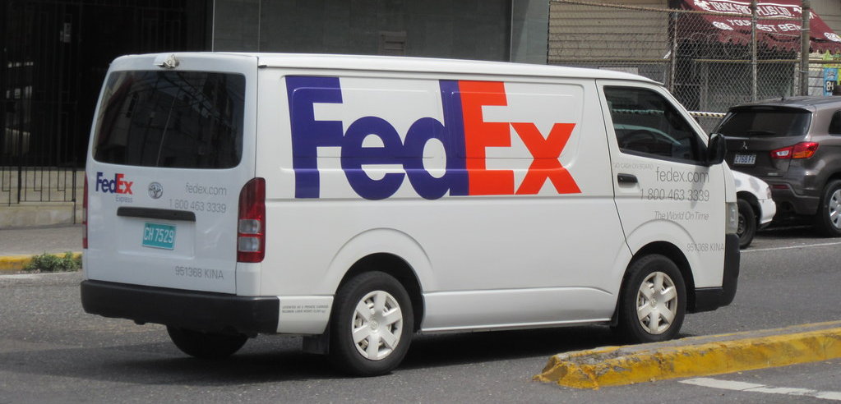
Banking is not the only point of comparison
Experience with brands outside of banking raises the bar
When talking about companies that stand out in terms of adding value to their business, customers talk about companies that innovate on products services with the needs of their business clearly in mind
I do a lot of work in eCommerce and I really enjoy using Shopify. Everything is set up in a way that is streamlined, integrated, and efficient. They also have a good customer service and tutorials/forums if I ever have questions
FedEx is my shipper of choice. They bend over backwards to always meet my business's needs. They also come up with innovative new products to help my shipping experience be even better. Although I have a small business, they always make me feel like a valued customer

Slide 22




A 360⁰ approach to Customer Centricity
The survey measured SBO perceptions of their primary banking FI on 3 pillars.
Overall, we measured 34 attributes across these pillars.
Innovation
Customer Service
Customer
Centricity
User Experience

Slide 23
The Phase 5 Customer Centricity Model
69%
Customer
Service
80%
Experience
(CX+UX)
31%
User / Digital
Experience
Overall, Experience is four times as important as Innovation as a driver of Customer Centricity.
Experience with Customer Service contributes more than twice as much to the index than UX or digital experience.
20%
Customer
Centricity
Innovation

Slide 24




What does the model imply for banks to be more customer-centric?
Customer service remains key. Banks need to work harder to get to know their small business customers – and to communicate that knowledge to them in meaningful ways.
Aim for consistency across touchpoints. Our modeling showed that, as drivers of customer centricity, many individual attributes across the pillars were interrelated.
Keep investing in digital but ensure there’s a person they can connect with. Digital channels and services are growing in importance. However, businesses see themselves as unique and many need a human in their corner.

Slide 25



Key take-aways – top banking needs of SBOs
In order to be perceived as customer centricity leaders, banks need to perform well on both innovation and experience fronts (and user experience contributes to both).
Differentiate via technology. Small businesses see the direct correlation of time to money, and appreciate the apps and online tools that get tasks done quickly.
SBOs are frustrated with communications that are clearly not targeted at their particular situation. Customized and proactive messaging is a well-appreciated differentiator.
Proactive fraud detection and customer service during a fraud investigation can greatly strengthen a banking relationship.

Slide 26
Q&A with
Audience
Laura Craig
VP, Client Success
Steve Hansen
Partner

Slide 27
Additional Questions?
Laura Craig
VP, Client Success
lcraig@delvinia.com
Steve Hansen
Partner
steveh@phase-5.com

