Slide 1

Customer Journey Mapping:
Driving a Customer Centric Culture from the Outside In
Tanya Fowler, Head of CX , FCT
Andreas Noe, Partner and CX Practice Lead , Phase 5
IA X Event, September 2021

Slide 2
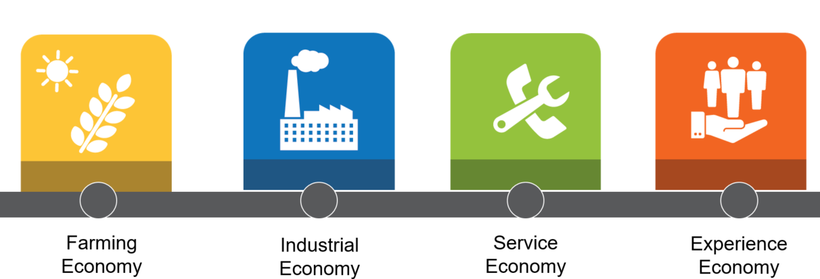

Driving a Customer Centric Culture from the Outside In
Why? The evolution and continued growth of CX…
“The last best experience that anyone has anywhere, becomes the minimum expectation for the experience they want everywhere.”
–
Bridget van Kranlingen, IBM

Slide 3
Driving a Customer Centric Culture from the Outside In
What? Take the Journey - together
1
4
Unify – from the Outside In
Strategy + Organizational Focus
Start at the top!
Break down silos by uniting customers + employees
Tackle the hard stuff!
2
5
Education
Start at the top!
Every employee’s role is critical
Research, Research!
Co-create foundational tools
Connect research insights to every role and initiative
3
6
Set the Stage
Define your customer
Give them the spotlight!
Ideate, Build + Celebrate

Slide 4
Driving a Customer Centric Culture
How?
Partnered with Phase5 to co-create customer journey and empathy map of high impact, high visibility customer segment
Defined and validated key customer persona
Delivered foundational tools to allow employees to step into the customers’ shoes
Key Learnings
DEFINE SUCCESS
INVEST IN RESEARCH
EMBED IN YOUR CULTURE
What does success look like?
What customer segment is most challenging but reaps highest reward?
Align with trusted partner
Co-create -what’s in it for them?
Talk about the lightbulb moments
Be prepared to pivot!
Share, share, share
Align with new hire on- boarding
Create customer wall

Slide 5
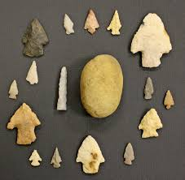
Important Aha’s from FCT’s CX Tools
The Tales We Told Ourselves and the Lessons We Learned
Empathy maps got us closer to our customer persona, put ourselves in their shoes: “Main Street” Law Clerk Sam
Journey maps helped to illustrate Sam’s cross-silo journey, both current state and desired future state
Design thinking generated ideas to solve a problem, but Victory Circle provided critical stress test

Slide 6


Lessons Learned from Sam’s Empathy Map
What We Knew
What We Imagined
What We Learned
Works in small law firm
Helps lawyers process real estate transactions
Extremely organized
True glue of law firm
Embraces automation, improvements to workflow
Moments of chaos cause considerable stress
Energized, frustrated at times
Uses FCT either frequently or selectively – lawyer decides, but she has considerable influence
Spirited, full of energy
Strong achievement motive
Really enjoys the work, explains long tenure
Spirited, full of energy
Strong achievement motive
Really enjoys the work, explains long tenure
Confident, empowered, in control, “I got this!”
Our best chance to win with Sam meant delivering on these desired emotional benefits

Slide 7

Lessons Learned from Sam’s Cross-Silo Journeys
The journey map developed by internal stakeholders was largely validated, more positive sentiment than expected
There was alignment on key pain points, for Sam and stakeholders (current state vs desired future state shown below)
No one, FCT included, was getting her to ‘wow’ level and never across silos: major opportunity for creating omni experiences
Current CX
Sam must be proactive to initiate contact when something is flagged
Updates rarely happen without prodding which creates more work
Limited transparency or visibility on progress
Process, steps and reporting channels used are inconsistent across products and platforms
Desired CX
  Have acknowledgement that issues are flagged and why
  Outline what else may be needed
  Disclose when she will hear back
  Share updates proactively, even if there is no progress to report yet
  Know who is working on it so she may check in as needed
  Greater consistency across platforms, products and channels
Common theme at three points in the journey: “black hole,” inconsistent communication when something is flagged, questioned, or needs more due diligence by FCT.
Confident, empowered, in control, “I got this!”

Slide 8
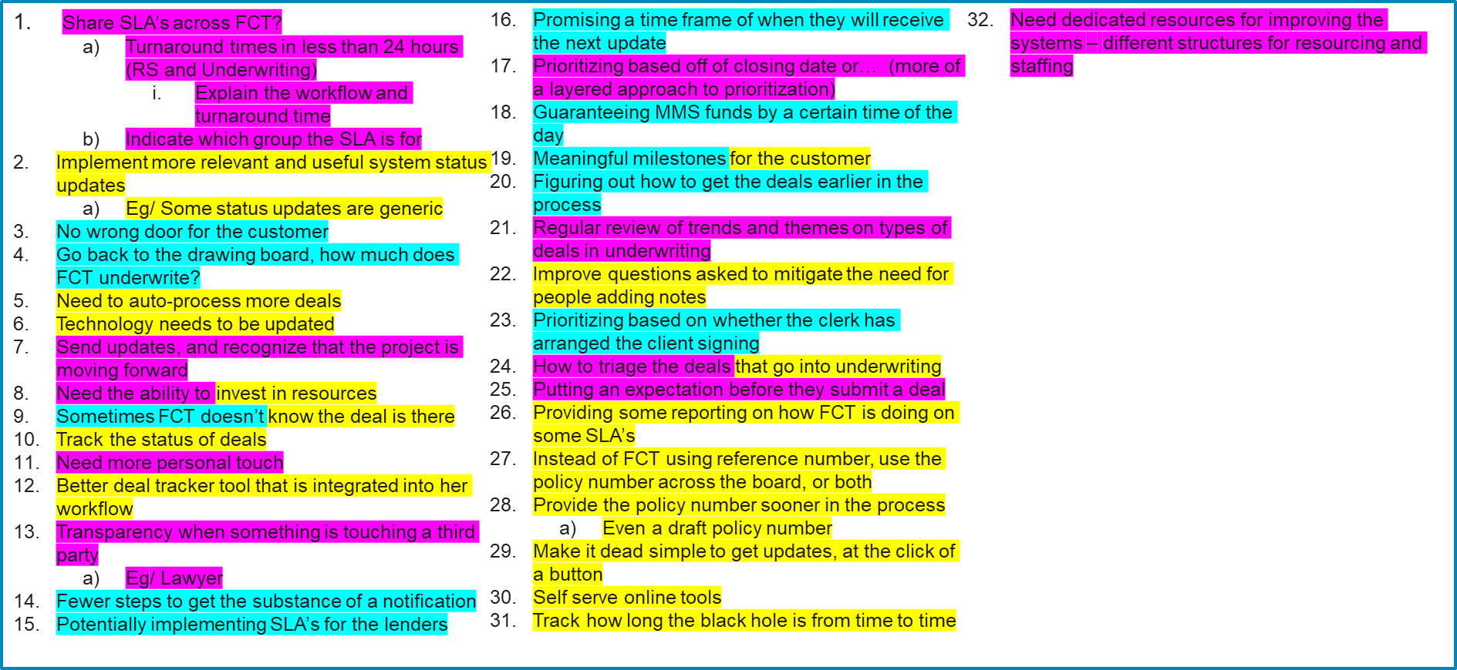
Lessons Learned from Ideation, Victory Circle
The team quickly developed 32 ideas to get Sam to her Victory Circle – a mix that touched on technology, business processes and workflows, and people
It did not get us very far – we had to revisit this through three dimensions:
  What is most important to Sam in her Victory Circle? Key feelings, core benefits
  What will have the biggest impact on this?
  What is easiest to do now?
There was no alignment on b and c
Confident, empowered, in control, “I got this!”
Most Impactful on CX | Easiest to Do
5,5,5,5,5,5,5 | 1,1,1,1,1,1,1,1,1,1,1,1
22,22 | 11,11,11,11,11,11,11
2,2,2,2 | 25,25,25
6,6,6,6,6,6,6 | 22
15 | 17
We were left with two choices between short-term vs long-term CX priorities:
Do what is easy and play in the margins
Do something bold, and own it

Slide 9
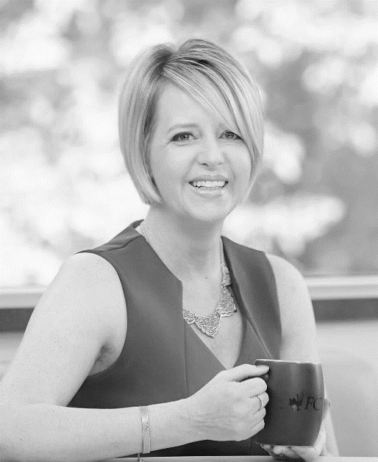

Thank you!
Tanya Fowler, CCXP
Head of CX, FCT
@tan_fowl
Andreas Noe
Partner, Phase5
@_Phase5

