Slide 1

Jobs to be Done:
A Framework for Uncovering Customer Needs
Steve Hansen
Partner, Phase 5
April 2021
Notes:
Good afternoon or morning or lunchtime everyone, thanks so much for taking the time to log on to yet another virtual meeting and endure the inevitable technical glitches.
My name is Steve Hansen. I am a partner and head of the data analytics practice at Phase 5, and I am going to talk to you about JTBD.
By way of background, I came to JTBD as a skeptic. It was 2005 or so. I was in market research at Thomson Reuters, a big information services company. There was a new book on the market that purported, once again, to solve the problem of innovation that people had been talking about for years, that problem that gazillions of new products – innovations that smart people have worked very hard to create – ultimately fail in the market.
I dutifully read the book. People were talking about it in the industry. I was somewhat interested at first. Our company even talked with the author’s company about potentially doing a project. But I concluded in the end this was a repackage. Like so many other fads it was just yesterday’s lunch put back in the skillet.
Now that book was based on JTBD and that was my first introduction to the concept. And I’m going to come back to that book at the end of the presentation.
But first, let’s fast-forward now 15 years. It’s 2020 and I’ve been working with JTBD in various forms for actually a dozen years or so.
So clearly my attitude changed, and it changed pretty soon after that first encounter.
I’m going to walk you through my change of heart, because I think it helps do what I promised we would do when I sent out my intro video for this presentation.

Slide 2
Overview
What “Jobs” has to offer
“Jobs” across silos
Quandaries
Resources
Getting started

Slide 3

What JTBD has to offer
Common framing and language
Product independent analysis ➔ true innovation
Deeper insights – different segmentations
Deeper insights – hidden jobs and adjacencies

Slide 4
Language: “Customer Requirements” into Jobs
Conversation | Interpretation
User: “I need a smartphone with more memory!”
Researcher: “Why?”
User: “I keep having to delete videos – they’re the things that take up most of the memory.”
Researcher: “Why are you taking video?”
User: “The grandkids!
Researcher: “Oh, so you’re trying to capture video of those special moments?”
User: “Yeah!” | Job: Capture video of important moments
What is a job?
A job is the thing someone needs to do; jobs should NOT reference any products or services used to get things done
In a job, you’re capturing something that will be true for many years, independent of the technology available to do that job

Slide 5
Language: “Customer Requirements” into Jobs
Conversation | Interpretation
User: “I need a smartphone with more memory!”
Researcher: “Why?”
User: “I keep having to delete videos – they’re the things that take up most of the memory.”
Researcher: “Why are you taking video?”
User: “The grandkids!
Researcher: “Oh, so you’re trying to capture video of those special moments?”
User: “Yeah!” | Job: Capture video of important moments
What is a job?
A job is the thing someone needs to do; jobs should NOT reference any products or services used to get things done
In a job, you’re capturing something that will be true for many years, independent of the technology available to do that job

Slide 6
Language: “Customer Requirements” into Jobs
Conversation | Interpretation
User: “I need a smartphone with more memory!”
Researcher: “Why?”
User: “I keep having to delete videos – they’re the things that take up most of the memory.”
Researcher: “Why are you taking video?”
User: “The grandkids!
Researcher: “Oh, so you’re trying to capture video of those special moments?”
User: “Yeah!” | Job: Capture video of important moments
What is a job?
A job is the thing someone needs to do; jobs should NOT reference any products or services used to get things done
In a job, you’re capturing something that will be true for many years, independent of the technology available to do that job

Slide 7
Language: “Customer Requirements” into Jobs
Conversation | Interpretation
User: “I need a smartphone with more memory!”
Researcher: “Why?”
User: “I keep having to delete videos – they’re the things that take up most of the memory.”
Researcher: “Why are you taking video?”
User: “The grandkids!
Researcher: “Oh, so you’re trying to capture video of those special moments?”
User: “Yeah!” | Job: Capture video of important moments
What is a job?
A job is the thing someone needs to do; jobs should NOT reference any products or services used to get things done
In a job, you’re capturing something that will be true for many years, independent of the technology available to do that job

Slide 8
Language: “Customer Requirements” into Jobs
Conversation | Interpretation
User: “I need a smartphone with more memory!”
Researcher: “Why?”
User: “I keep having to delete videos – they’re the things that take up most of the memory.”
Researcher: “Why are you taking video?”
User: “The grandkids!
Researcher: “Oh, so you’re trying to capture video of those special moments?”
User: “Yeah!” | Job: Capture video of important moments
What is a job?
A job is the thing someone needs to do; jobs should NOT reference any products or services used to get things done
In a job, you’re capturing something that will be true for many years, independent of the technology available to do that job

Slide 9
Language: “Customer Requirements” into Jobs
Conversation | Interpretation
User: “I need a smartphone with more memory!”
Researcher: “Why?”
User: “I keep having to delete videos – they’re the things that take up most of the memory.”
Researcher: “Why are you taking video?”
User: “The grandkids!
Researcher: “Oh, so you’re trying to capture video of those special moments?”
User: “Yeah!” | Job: Capture video of important moments
What is a job?
A job is the thing someone needs to do; jobs should NOT reference any products or services used to get things done
In a job, you’re capturing something that will be true for many years, independent of the technology available to do that job

Slide 10
Language: job “success” turns into metrics
Conversation | Interviewer Interpretation
User: “I took lots of video with my own kids on VHS years ago. We still love them. In those days we ran out of videotape, now it’s memory!”
Researcher: “So storage capacity is important, even today?” | Metric: Minimize storage constraints
User: “Yeah, of course things are better. In those days we had to drag the camcorder out of the closet, but now it’s just the phone out of my purse, so I get a lot more great videos.”
Researcher: “So you’re able to capture a lot more?”
User: “Yeah, but you get greedy. It’s still not fast enough. Sometimes I grab the phone and then fumble with my glasses and the button to start recording, and by the time I’m there, the cute moment is already gone.”
Researcher: “Oh, so the speed to start recording is important?”
User: “Absolutely.” | Metric: Minimize the time between wanting to record a moment and actually starting to capture video
What is a metric?
The metrics are the way that you measure the success of a new product, or a new service
By innovating against the most important and least satisfied metrics, you can differentiate your offering
A single job will have MANY metrics, minimally 30 and usually more; we usually preface them with “minimize” or “maximize” to indicate the desired direction of change

Slide 11
Language: job “success” turns into metrics
Conversation | Interviewer Interpretation
User: “I took lots of video with my own kids on VHS years ago. We still love them. In those days we ran out of videotape, now it’s memory!”
Researcher: “So storage capacity is important, even today?” | Metric: Minimize storage constraints
User: “Yeah, of course things are better. In those days we had to drag the camcorder out of the closet, but now it’s just the phone out of my purse, so I get a lot more great videos.”
Researcher: “So you’re able to capture a lot more?”
User: “Yeah, but you get greedy. It’s still not fast enough. Sometimes I grab the phone and then fumble with my glasses and the button to start recording, and by the time I’m there, the cute moment is already gone.”
Researcher: “Oh, so the speed to start recording is important?”
User: “Absolutely.” | Metric: Minimize the time between wanting to record a moment and actually starting to capture video
What is a metric?
The metrics are the way that you measure the success of a new product, or a new service
By innovating against the most important and least satisfied metrics, you can differentiate your offering
A single job will have MANY metrics, minimally 30 and usually more; we usually preface them with “minimize” or “maximize” to indicate the desired direction of change

Slide 12
Language: job “success” turns into metrics
Conversation | Interviewer Interpretation
User: “I took lots of video with my own kids on VHS years ago. We still love them. In those days we ran out of videotape, now it’s memory!”
Researcher: “So storage capacity is important, even today?” | Metric: Minimize storage constraints
User: “Yeah, of course things are better. In those days we had to drag the camcorder out of the closet, but now it’s just the phone out of my purse, so I get a lot more great videos.”
Researcher: “So you’re able to capture a lot more?”
User: “Yeah, but you get greedy. It’s still not fast enough. Sometimes I grab the phone and then fumble with my glasses and the button to start recording, and by the time I’m there, the cute moment is already gone.”
Researcher: “Oh, so the speed to start recording is important?”
User: “Absolutely.” | Metric: Minimize the time between wanting to record a moment and actually starting to capture video
What is a metric?
The metrics are the way that you measure the success of a new product, or a new service
By innovating against the most important and least satisfied metrics, you can differentiate your offering
A single job will have MANY metrics, minimally 30 and usually more; we usually preface them with “minimize” or “maximize” to indicate the desired direction of change

Slide 13
Language: job “success” turns into metrics
Conversation | Interviewer Interpretation
User: “I took lots of video with my own kids on VHS years ago. We still love them. In those days we ran out of videotape, now it’s memory!”
Researcher: “So storage capacity is important, even today?” | Metric: Minimize storage constraints
User: “Yeah, of course things are better. In those days we had to drag the camcorder out of the closet, but now it’s just the phone out of my purse, so I get a lot more great videos.”
Researcher: “So you’re able to capture a lot more?”
User: “Yeah, but you get greedy. It’s still not fast enough. Sometimes I grab the phone and then fumble with my glasses and the button to start recording, and by the time I’m there, the cute moment is already gone.”
Researcher: “Oh, so the speed to start recording is important?”
User: “Absolutely.” | Metric: Minimize the time between wanting to record a moment and actually starting to capture video
What is a metric?
The metrics are the way that you measure the success of a new product, or a new service
By innovating against the most important and least satisfied metrics, you can differentiate your offering
A single job will have MANY metrics, minimally 30 and usually more; we usually preface them with “minimize” or “maximize” to indicate the desired direction of change

Slide 14
Language: potential constraints on hitting the metrics
Conversation | Interviewer Interpretation
Researcher: “Just out of curiosity, why do you need your glasses?”
User: “It’s hard for me to get to the video app without them. My eyes are really bad, but sometimes I’m playing with the kids so I have my glasses off.” | Constraint: Limited visual acuity
What is a constraint?
Constraints are the external factors that can reduce success against one or more metrics
Constraints can be helpful in targeting particular customers / users in particular situations; e.g. products designed for extreme weather conditions, or for people with permanent or situational disabilities

Slide 15
Language: potential constraints on hitting the metrics
Conversation | Interviewer Interpretation
Researcher: “Just out of curiosity, why do you need your glasses?”
User: “It’s hard for me to get to the video app without them. My eyes are really bad, but sometimes I’m playing with the kids so I have my glasses off.” | Constraint: Limited visual acuity
What is a constraint?
Constraints are the external factors that can reduce success against one or more metrics
Constraints can be helpful in targeting particular customers / users in particular situations; e.g. products designed for extreme weather conditions, or for people with permanent or situational disabilities

Slide 16
Language: potential constraints on hitting the metrics
Conversation | Interviewer Interpretation
Researcher: “Just out of curiosity, why do you need your glasses?”
User: “It’s hard for me to get to the video app without them. My eyes are really bad, but sometimes I’m playing with the kids so I have my glasses off.” | Constraint: Limited visual acuity
What is a constraint?
Constraints are the external factors that can reduce success against one or more metrics
Constraints can be helpful in targeting particular customers / users in particular situations; e.g. products designed for extreme weather conditions, or for people with permanent or situational disabilities

Slide 17
Language: potential constraints on hitting the metrics
Conversation | Interviewer Interpretation
Researcher: “Just out of curiosity, why do you need your glasses?”
User: “It’s hard for me to get to the video app without them. My eyes are really bad, but sometimes I’m playing with the kids so I have my glasses off.” | Constraint: Limited visual acuity
What is a constraint?
Constraints are the external factors that can reduce success against one or more metrics
Constraints can be helpful in targeting particular customers / users in particular situations; e.g. products designed for extreme weather conditions, or for people with permanent or situational disabilities

Slide 18
Using JTBD requires Jobs, Metrics, AND Constraints
Job | Metrics | Constraints
Capture video of important moments | Minimize the time between wanting to record a moment and actually starting to capture video Minimize storage constraints Maximize aesthetic appeal of video … and many more | User capturing video has limited physical capabilities: eyesight, shaky hands, etc. User capturing video has no technical training Area in which video is captured has limited internet Extreme weather conditions … and many more
“overarching goal” | “measure success” | “what limits success”
Note: Adjacent jobs are also critical – see the quandaries section

Slide 19
Using JTBD requires Jobs, Metrics, AND Constraints
Job | Metrics | Constraints
Capture video of important moments | Minimize the time between wanting to record a moment and actually starting to capture video Minimize storage constraints Maximize aesthetic appeal of video … and many more | User capturing video has limited physical capabilities: eyesight, shaky hands, etc. User capturing video has no technical training Area in which video is captured has limited internet Extreme weather conditions … and many more
“overarching goal” | “measure success” | “what limits success”
Note: Adjacent jobs are also critical – see the quandaries section

Slide 20
Using JTBD requires Jobs, Metrics, AND Constraints
Job | Metrics | Constraints
Capture video of important moments | Minimize the time between wanting to record a moment and actually starting to capture video Minimize storage constraints Maximize aesthetic appeal of video … and many more | User capturing video has limited physical capabilities: eyesight, shaky hands, etc. User capturing video has no technical training Area in which video is captured has limited internet Extreme weather conditions … and many more
“overarching goal” | “measure success” | “what limits success”
Note: Adjacent jobs are also critical – see the quandaries section

Slide 21
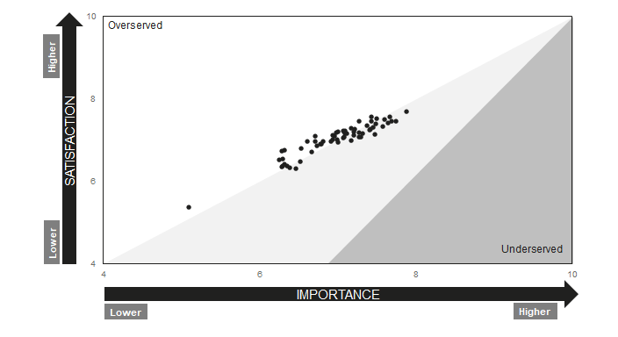
Deeper market insights
Identifying priority segments

Slide 22
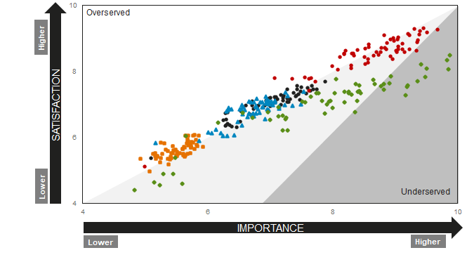
Deeper market insights
Identifying priority segments

Slide 23
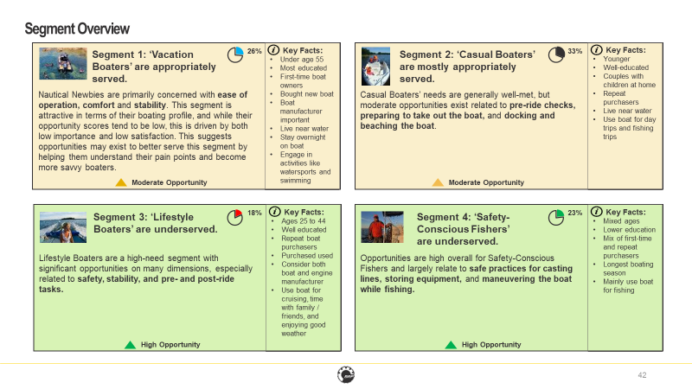
Targeted Innovation – Not Just Product Innovation

Slide 24
Deeper market insights
Hidden and adjacent jobs
Hidden jobs
“I could never find budget for that”
“Can we get this after I retire?”
Adjacencies
Maintaining vs riding a motorcycle
Financial market data vs. data modeling templates
How many products did a smartphone retire?
Job: obtain budget for significant purchase
New Metric: Minimize the effort needed to convince others of budgetary need

Slide 25
Overview
What “Jobs” has to offer
“Jobs” across silos
Quandaries
Resources
Getting started

Slide 26

JTBD across silos
More mindset than department
Pairs well with customer journeys and workflow mapping
Sandwich collaboration
Customer value-based ideation

Slide 27
JTBD, more mindset than department:
It is for those who want a deeper understanding of customer value
Mindset
Helping actual customers
Fair value exchange
> Customer Advocate
> Value Pricing
Psychology
Team | Questions JTBD helps with
Product / Innovation | How best to improve an existing product or expand product line; which concepts should win
Strategy | How to preempt disruption with products out-of-line with current value proposition
UX | How to prioritize content and user tasks
Marketing | How to identify priority segments; how to speak with customers on their own terms
Sales | How to triage new prospects and quickly understand the problems to solve
Support | How to best serve customers by focusing on the task they are trying to accomplish

Slide 28
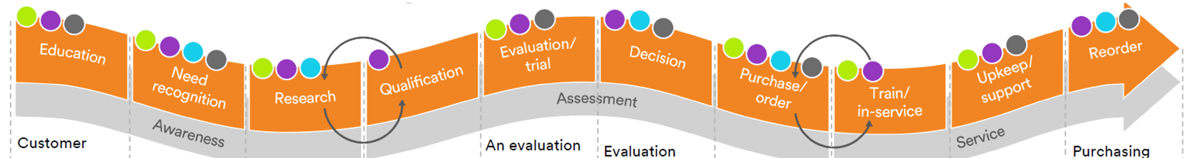
Pairs well with customer journeys and workflow mapping
  Jobs, jobs everywhere
  Identify key stakeholders by stage and activity
  Don’t try to eat the whole thing

Slide 29


Sandwich collaboration (manage change)
How buy-in needs to start before the first customer is interviewed
  Everyone who might object
  Hypotheses, concepts, plans
  Actual customers
  Their views first, then reactions
  Ride-alongs and co-analysis
  Same players
  Framed ideation (see next slide)

Slide 30
Customer value-based ideation
Perhaps more than other types of research, JTBD needs to be embraced by business owners because it requires extensive follow-up. The upside is it’s uniquely well-suited to fueling ideation.
Tips to handoff ideation:
  Cross-functional ideation team(s): marketing, NPD, Operations, CX…
  Intro and primer on JTBD, with reference handout
  Structure idea generation around jobs, metrics, and constraints
  Structure idea evaluation around
    Customers – jobs, metrics, constraints
    Company (internal)
    Note that the third C, competition, is already included

Slide 31
Overview
What “Jobs” has to offer
“Jobs” across silos
Quandaries
Resources
Getting started

Slide 32

Quandaries in JTBD
Uncovering jobs, metrics, constraints
Job types: functional – social – emotional
Job importance and choice of metrics

Slide 33
Uncovering jobs, metrics, constraints
Getting away from the faster horse…
Conversation | Interpretation
User: “I need a smartphone with more memory!” | Not necessarily!
Researcher: “Why?”
User: “I keep having to delete videos – they’re the things that take up most of the memory.”
Researcher: “Why are you taking video?”
User: “The grandkids!
Researcher: “Oh, so you’re trying to capture video of those special moments?”
User: “Yeah!” | Job: Capture video of important moments
What is a job?
A job is the thing someone needs to do; jobs should NOT reference any products or services used to get things done
In a job, you’re capturing something that will be true for many years, independent of the technology available to do that job

Slide 34



Job types: functional – social – emotional
In B2B there is a (misguided) tendency to focus only on functional needs
Functional Jobs
Social Jobs
Emotional Jobs
Relate to how the solution operates.
For an information services market, common functional needs will include:
  Speed
  Effort
  Accuracy
  Efficiency
Contribute to how we are viewed by others and our need for interaction.
In B2B, common social needs would include focus on status and teamwork. Status could relate to:
Expertise
Intelligence
Reliability
Responsiveness
Position
Recognition
Compensation
Relate to how an experience makes us feel.
In B2B, emotional needs could include feelings of:
Competency / mastery
Control
Confidence
Productivity
Embarrassment / shame
Resentment

Slide 35
Job importance and choice of metrics
In flying, it’s very important that the plane not crash, but…
  That the metric is important is only the beginning
  Think in terms of underserved and overserved metrics
  Important but well-served metrics make good anchors
  Metric choice: absolute outcomes (zero / qualifying threshold) are different from soft metrics (minimize waste)

Slide 36
Overview
What “Jobs” has to offer
“Jobs” across silos
Quandaries
Resources
Getting started

Slide 37
Getting started: first, adopt the mindset
In your functional area, in your department – it works to start small
  Identify who your “customers” are:
    User? Buyer? Stakeholder? Leslie from Marketing?
  Start with trying to understand the problem or need, not a solution
  Practice breaking down tasks into components
  Be open to the idea that one task may serve multiple needs
  Think beyond functional needs – How do my customers want to feel? How do they want to be seen by others?

Slide 38
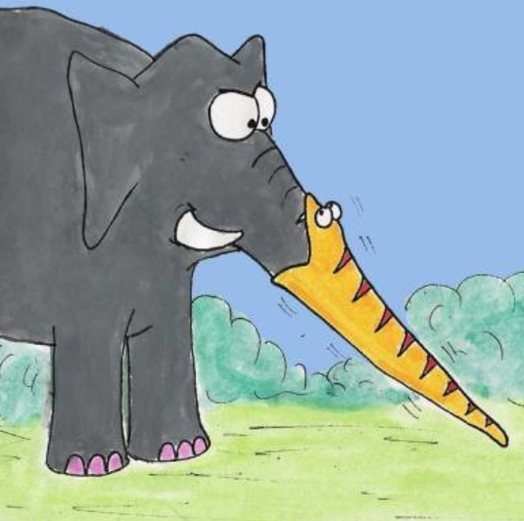
Scoping your JTBD inquiry
Risky in either direction…
Tips:
Use a customer journey map to help define scope – focus on jobs in 1-2 stages of the journey for single study
Use internal planning sessions to better define scope (e.g. areas where we think there are more pain points, where we have technology or resources to address needs, etc.)
Use the interview-length rule – if you can’t finish the needs-identification interview in 60-90 minutes, your scope is likely too broad
Feeling the need to combine specific metrics into more general ones may indicate too broad a scope
Expect to identify at least 25-30 metrics for a job. If you have fewer, you can likely expand your scope
  Too broad: identifying all relevant needs will require a multi-step process (e.g. separate streams for different activities)
  Too narrow: there may be too few underserved needs uncovered to invest in innovation

Slide 39
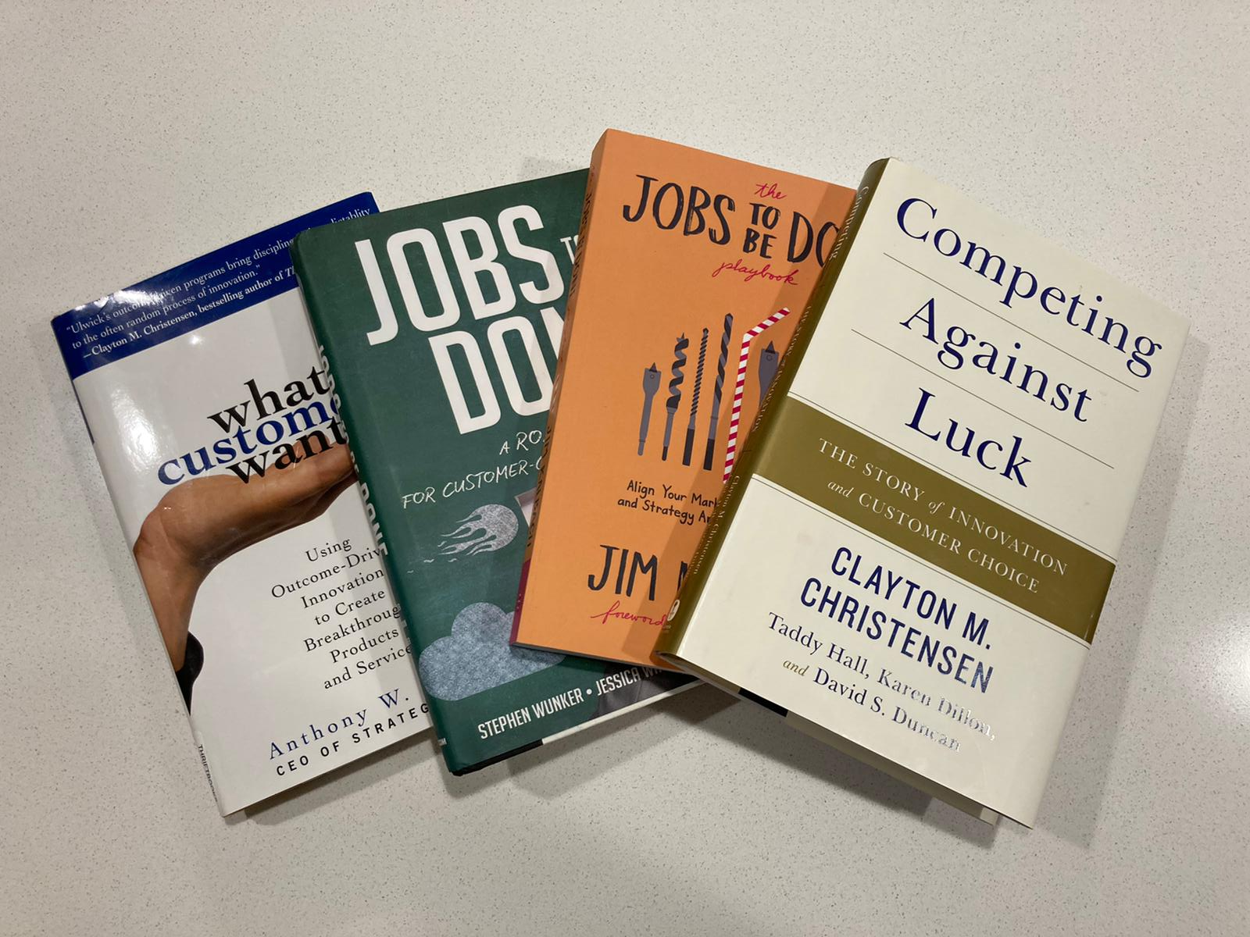
Resources for JTBD
Foundational
Practitioner / how-to

Slide 40
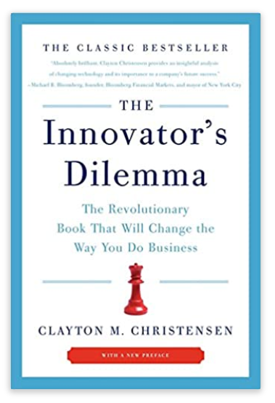
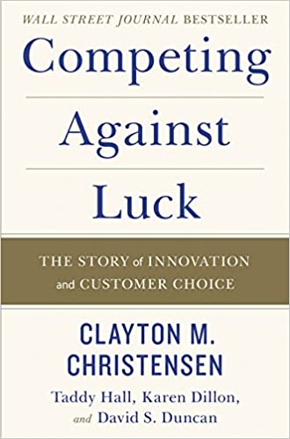

Foundational JTBD resources

Slide 41
Practitioner: Cheat sheet for getting started with jobs
Job | Metrics (30+) | Constraints (knowledge / training, environmental, legal, social…)
What is a job?
A job is the thing someone needs to do; jobs should NOT reference any products or services used to get things done
In a job, you’re capturing something that will be true for many years, independent of the technology available to do that job
What is a metric?
The metrics are the way that you measure the success of a new product, or a new service
By innovating against the most important and least satisfied metrics, you can differentiate your offering
A single job will have MANY metrics, minimally 30 and usually more; we usually preface them with “minimize” or “maximize” to indicate the desired direction of change
What is a constraint?
Constraints are the external factors that can reduce success against one or more metrics
Constraints can be helpful in targeting particular customers / users in particular situations; e.g. products designed for extreme weather conditions, or for people with permanent or situational disabilities

Slide 42

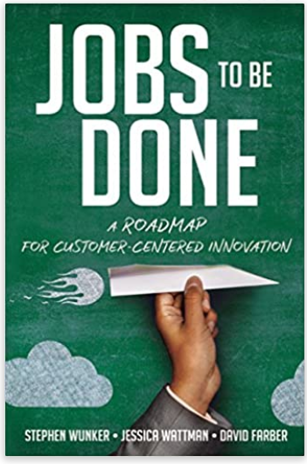
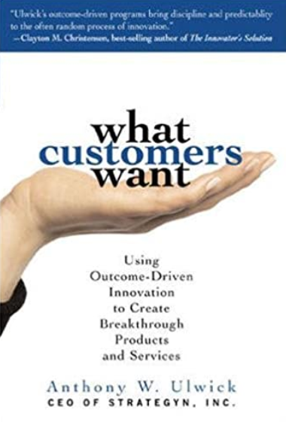
Practitioner: other JTBD resources
Key topic | 1 | 2 | 3
Moving from Jobs to value pricing |  | X
Effective JTBD interviewing (not easy!) | X
Actual job mapping | X
How to ideate and evaluate based on JTBD | X |  | X
Breakdown of JTBD elements to analyze | X |  | X
How to encourage adoption of JTBD |  | X
The JTBD Playbook (Kalbach)
Jobs to be Done (Wunker et al.)
What Customers Want (Ulwick)

Slide 43


For questions or more information please contact:
Steve Hansen
Partner
(612) 509-5000 x305
steveh@phase-5.com
Stephan Sigaud
EVP Marketing
(416) 599-7555 x232
stephans@phase-5.com

