Slide 1
“I believe in the spirit of
entrepreneurship now
more than ever.”
Small Talk Panelist and Business Owner

Slide 2

99 SENSE
The Future Looks Good for SMBs
PHASE 1

Slide 3

WHY
WE’RE
HERE

Slide 4

We’re Here To Talk About
Where we are now
Where we will be soon
Where we want to be
What challenges lie along the way
How we’re going to get there

Slide 5







We talked to, listened to, and researched business owners in the US and Canada
to find out
How they’re doing
What they’re doing
Where they’re going
RESEARCH POWERED BY
RESEARCH IN COLLABORATION WITH

Slide 6
We combined our primary research, secondary research, and curated articles with our own expertise and interpretations.
Together, they have helped us form our observations, a way forward.
This is Project 99.

Slide 7

Informed Observations Affect
Messaging
Targeting
Brand
Content
Retention

Slide 8
“[It’]s exhaust[ing], given all
the opportunities countered
with all the uncertainties.”
Small Talk Panelist and Business Owner

Slide 9

WHERE WE ARE
NOW
+
WHERE WE’RE
GOING

Slide 10

The Good News
Overall, business owners are more optimistic and positive than the media suggests.

Slide 11
In unaffected industries
• Seeing big opportunities
• Leveraging business-building
capabilities
• Attacking rapidly
In affected industries
• Focused on the positive
• Quickly adjusting to shifting
needs
• Learning new capabilities
Across the
board
Refueling their best traits:
• Serving others
• Leading with empathy
• Ingenuity/creativity
• Devising business solutions to
significant problems

Slide 12

But the pain
is real.

Slide 13
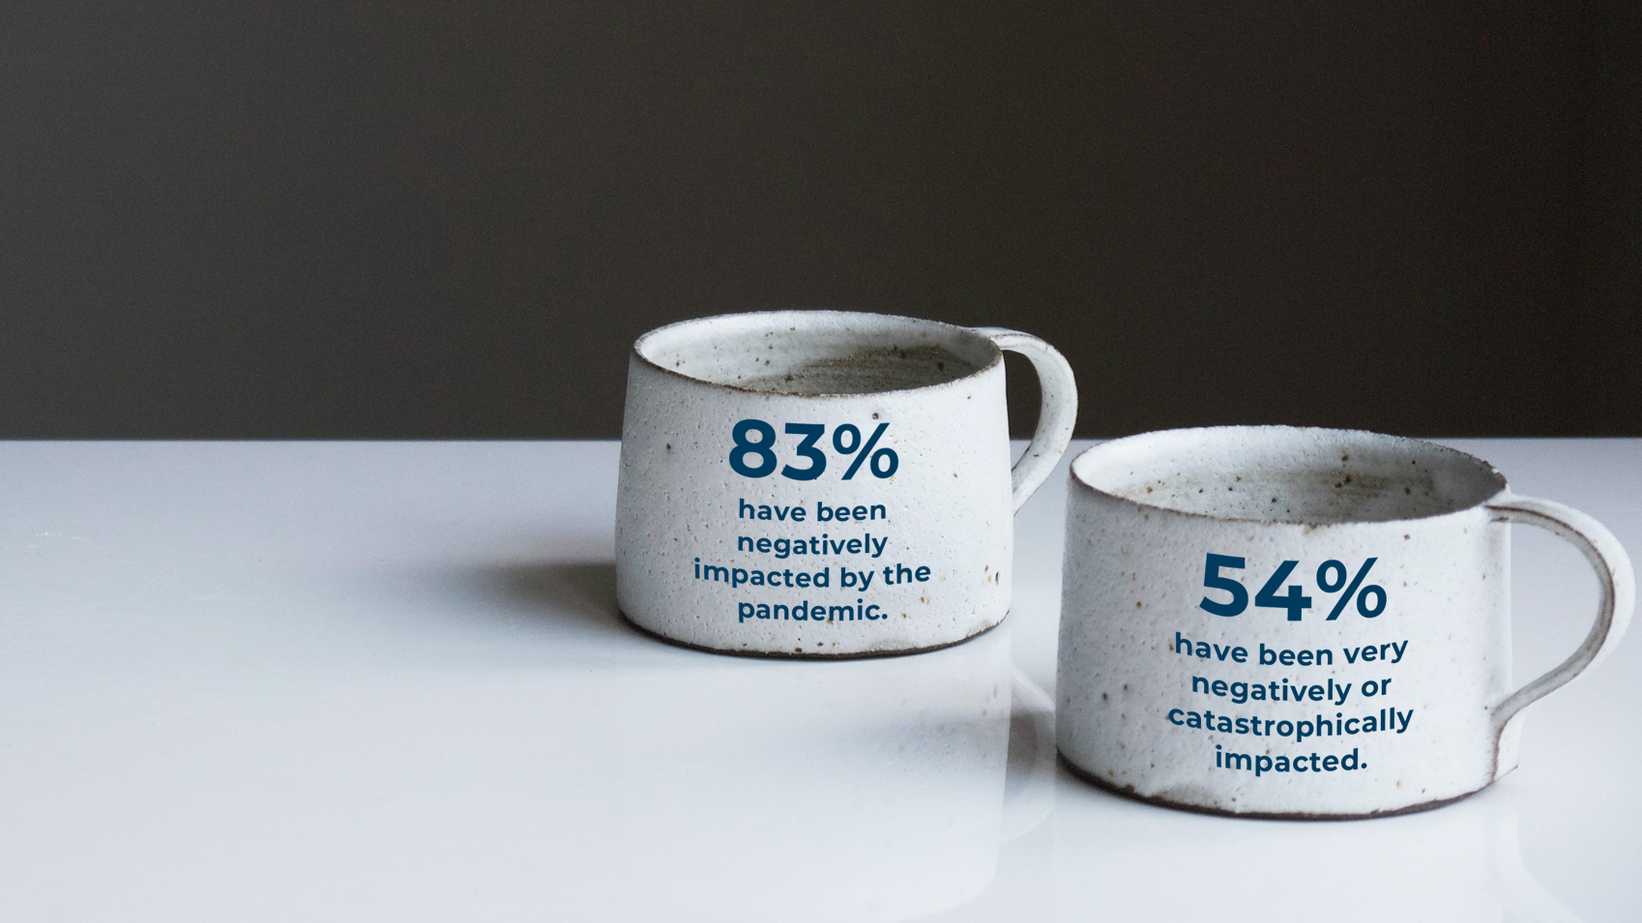

Slide 14

When will business
return to pre-shutdown
levels?

Slide 15
30%
29%
38%
say within
6 months
say within
6-12 months
say within
12+ months

Slide 16

47%
had to pivot or change what they do since shutdown began.

Slide 17
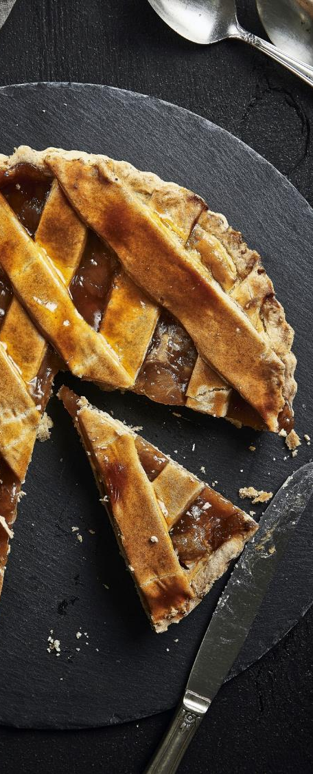
However,
58%
are optimistic about the future of their business.

Slide 18

And only
6%
are pessimistic.

Slide 19

THE
FUTURE
FORWARD

Slide 20
“My current emotional state about my
business is positive. I think this is a great
time for innovation.”
Elizabeth Power, Founder,
The EPower Change Institute at EPower & Associates, Inc.
“I feel positive about my company’s future.”
Jay Wingfield, Attorney
“We are pivoting and discarding the old
ways of business and embracing change.”
Linda Clasen, Senior Level Marketer

Slide 21

How are business owners doing it?
Resiliency
Speedy Adaptation
Agility

Slide 22
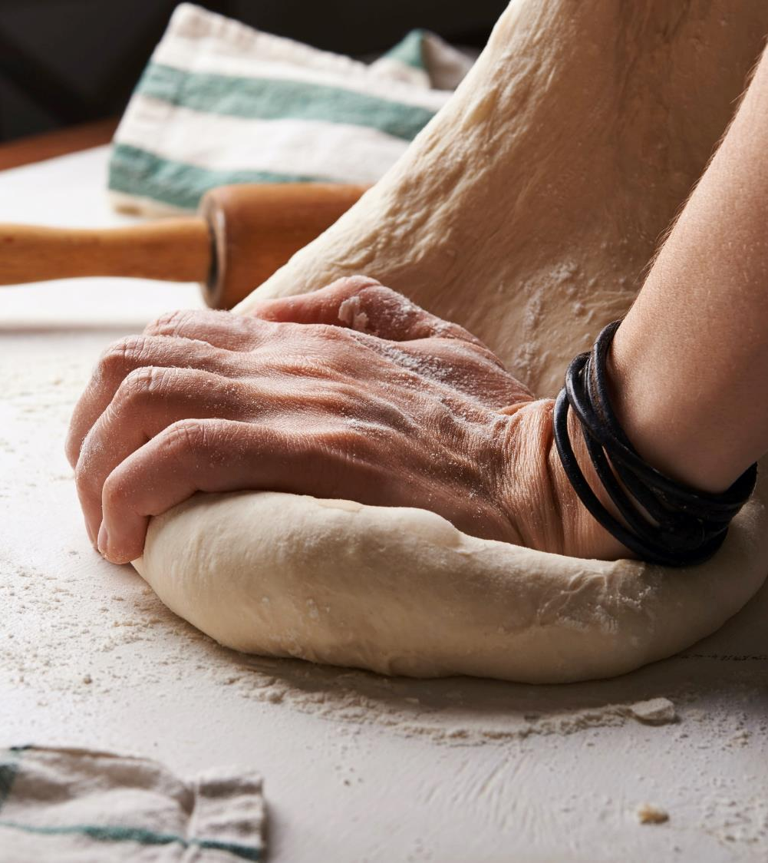
They see an opportunity to
exhale, be self-reflective,
and come out of this
a better human and a better business owner.

Slide 23
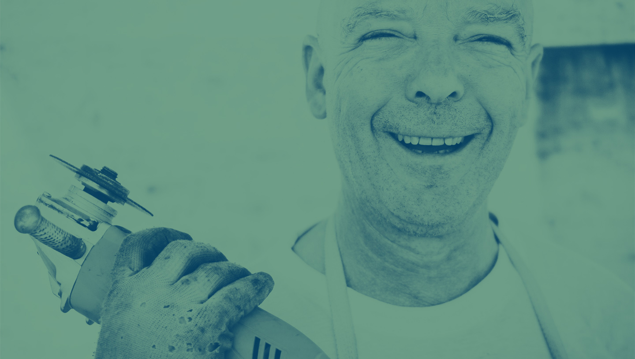
This is a time for reinvention.
And business owners are
leading the charge.

Slide 24

But where
are they
leading us?
To the
“New Normal.”

Slide 25

Let’s
not
go
back
to
work.
Let’s
go
forward
to
work.

Slide 26
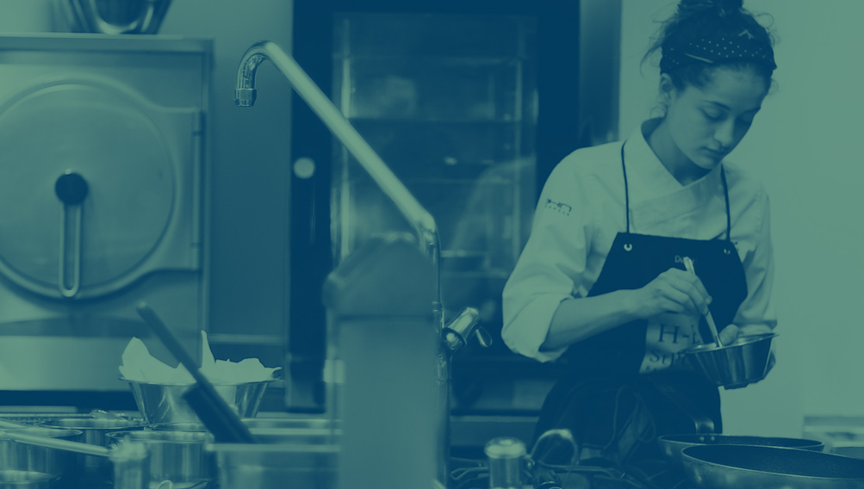
66% of all SBOs feel their business model will change or evolve because of the pandemic.

Slide 27

How?

Slide 28

Digitization
63%
42%
plan more online business
plan to digitize their operations and processes

Slide 29

Innovation
38%
33%
plan to launch a new product within 6 months
plan to shift their customer focus in the same period

Slide 30
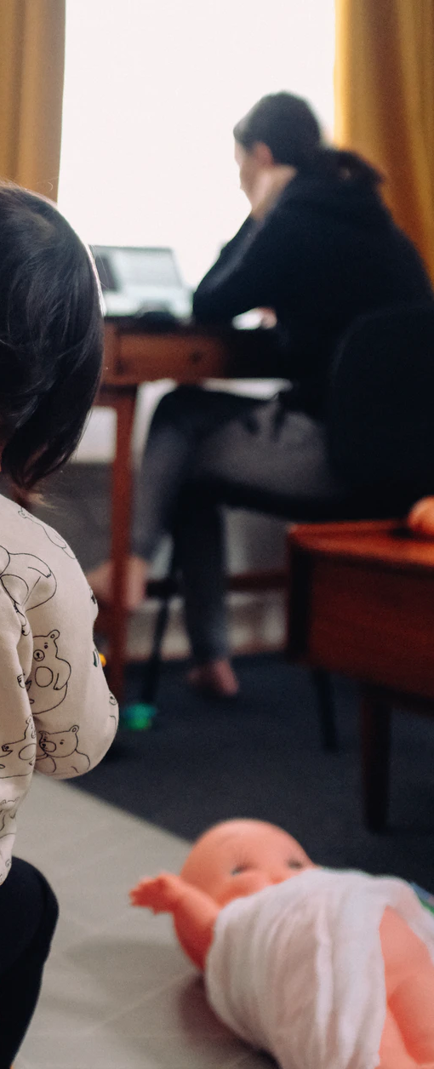
Work From Home
77%
48%
currently allow employees to WFH
of those will make it permanent
Only
42%
10%
allow for 12 months
will end WFH once business is fully open

Slide 31

Purpose
When consumers think a brand has a strong purpose, they are:
4 x
6 x
more likely to purchase from the company
more likely to protect the company in the event of a misstep or public criticism
4.5 x
4.1 x
times more likely to champion the company and recommend it to friends and family
times more likely to trust the company
— June 2020 Zeno Strength of Purpose Study —

Slide 32
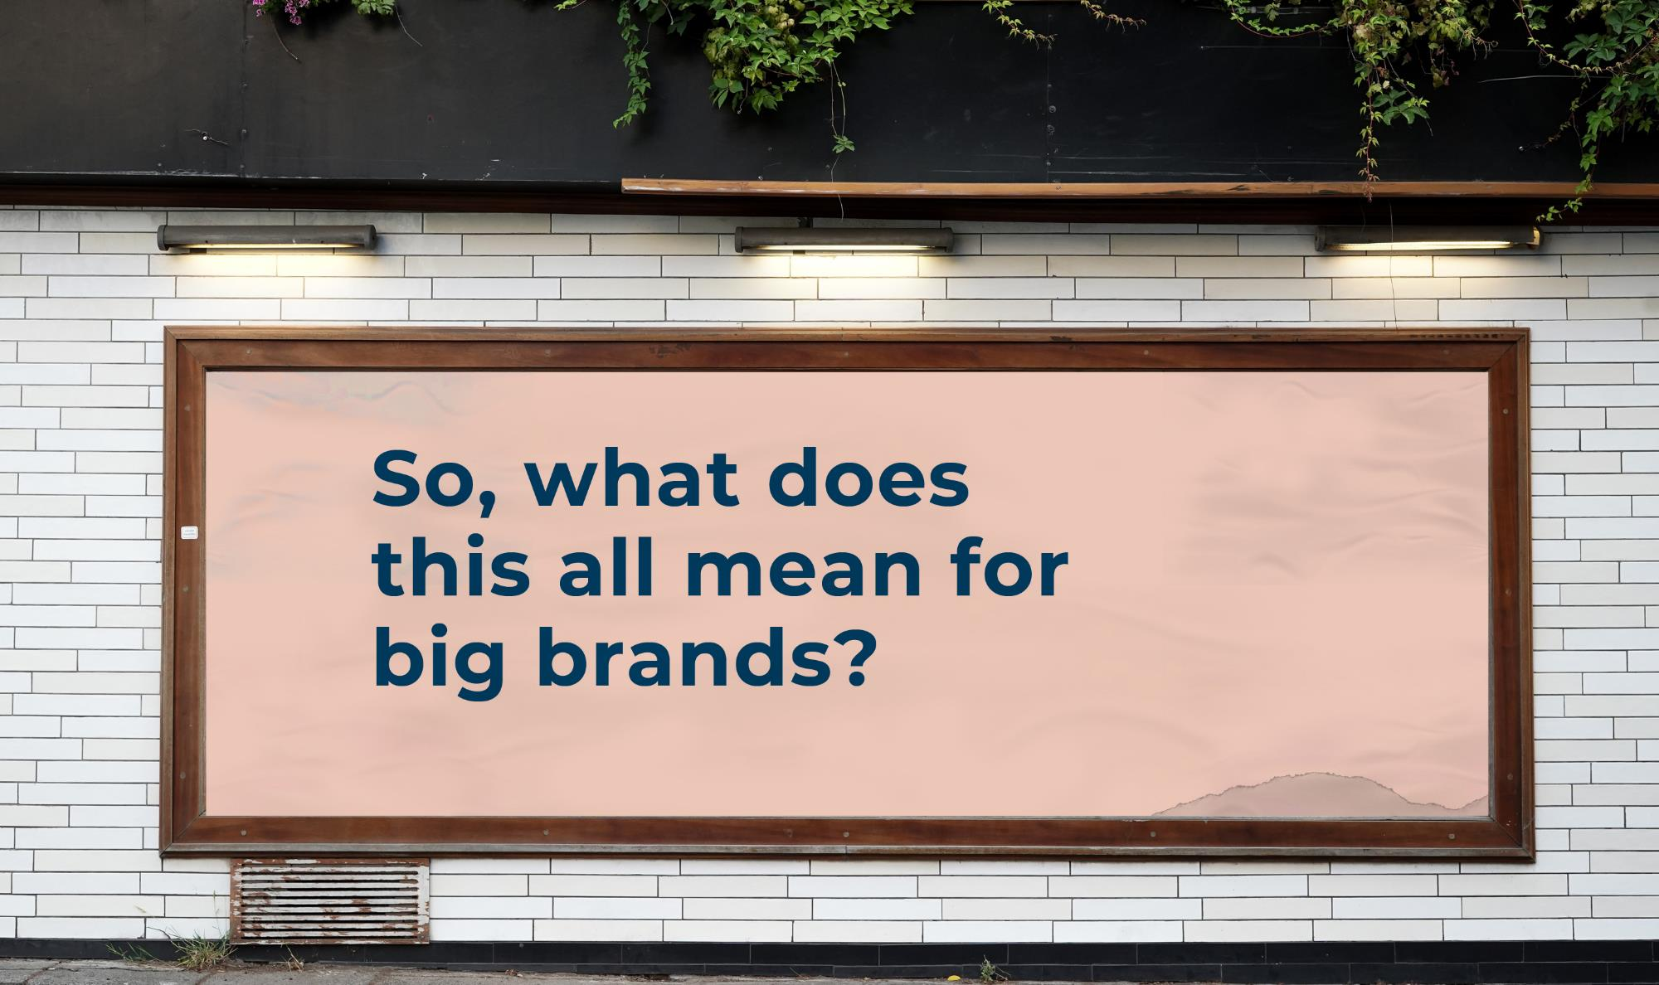

Slide 33

Have an optimistic message and tone.
1
1 in 5 of national ads are COVID-19 related.
Consumers are over the “we’re in this together” thing from big brands.
(Ad Age Magazine, May 2020)

Slide 34
Have an optimistic message and tone.
1
Instead focus on
Authenticity — Pioneering — Partnership — Positivity

Slide 35

2
Be agile.
small wins and shorter plays
big campaigns and extended flights

Slide 36
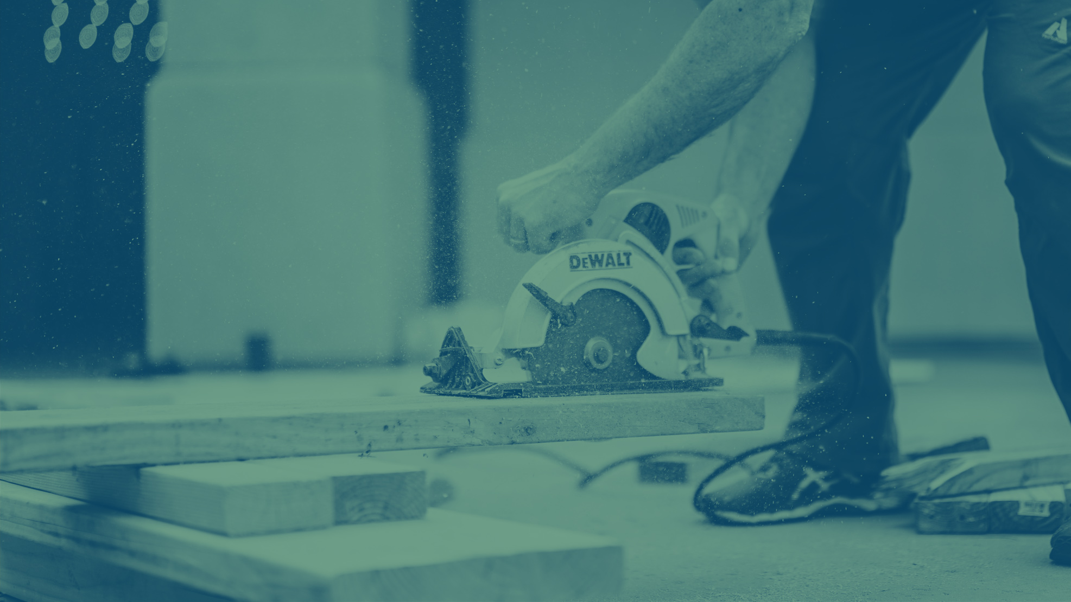
3
Purpose over FABs.
“Do well by doing good” is not a new strategy.
But now is the time to embrace it.

Slide 37
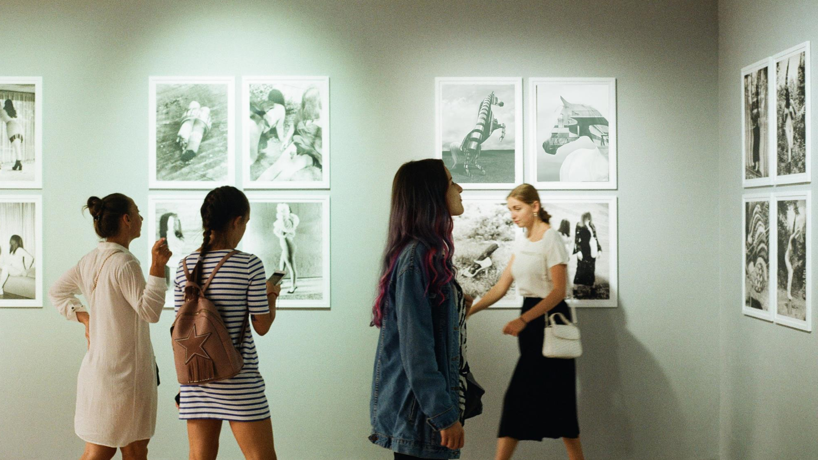
WHERE WE
WANT
TO BE

Slide 38

The road to recovery will depend on geography & government, business lifecycle, and the industry.

Slide 39
Let’s
dive
deeper

Slide 40

Government mandated re-opening in the US and Canada
1

Slide 41
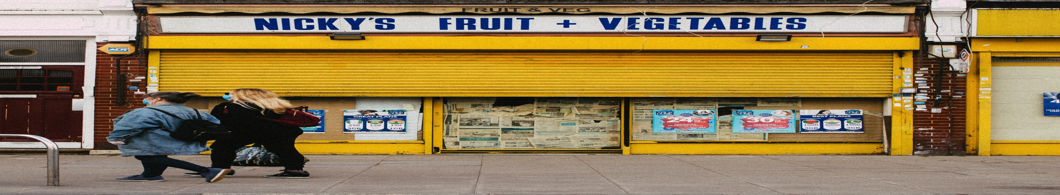
Smaller metros and towns will
re-open sooner.
Areas with higher infection rates and large metros will re-open later.
1

Slide 42
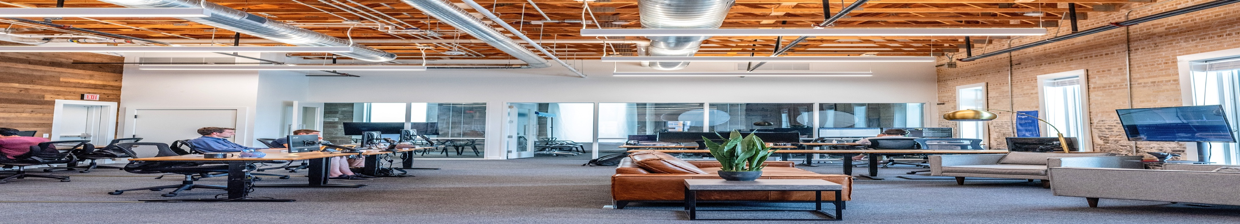
Younger and smaller businesses (0-5 years, less than 20 employees) will have the hardest time.
2

Slide 43
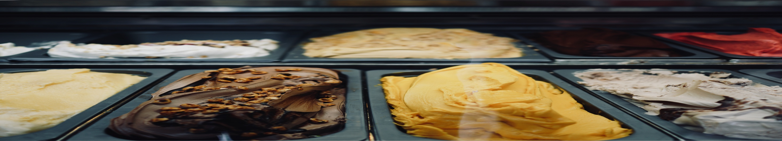
Why?
Lower degrees of liquidity.
Greater credit constraints.
2

Slide 44

They will recover. It will simply take longer.
2

Slide 45
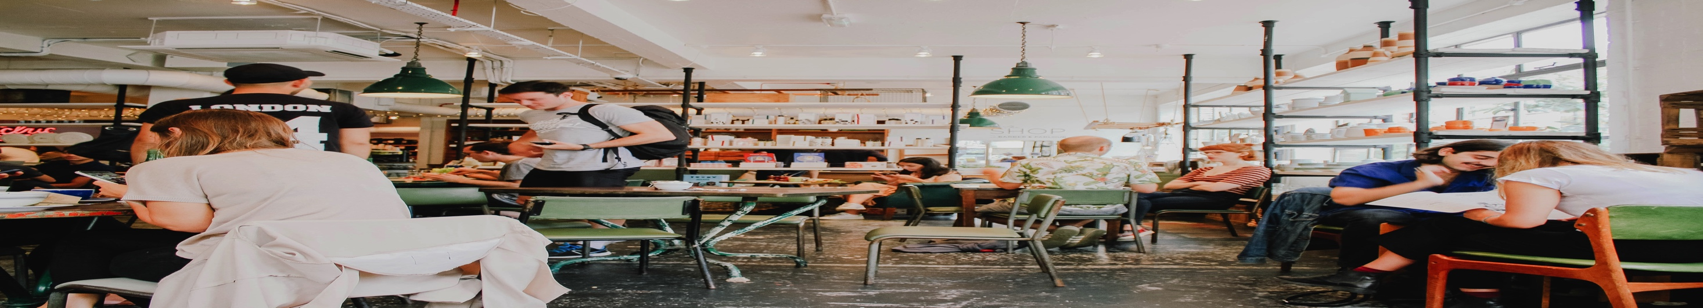
The industry’s reliance on “high-touch” environments.
3

Slide 46

The hardest hit industries are the ones with large gatherings, close human interaction, critical hygiene, dependence on travel, and are expendable or postponable.
3

Slide 47

There will be
3 speeds of recovery

Slide 48
SLOW
Personal service, hospitality, sports/entertainment, travel

Slide 49
MEDIUM
Manufacturing, construction, retail, banking, insurance
SLOW
Personal service, hospitality, sports/entertainment, travel

Slide 50
FAST
Professional services, utilities, telecom, pharma
MEDIUM
Manufacturing, construction, retail, banking, insurance
SLOW
Personal service, hospitality, sports/entertainment, travel

Slide 51

Recovery speed can be
Increased through
digitization , curbside pickup and delivery, touchless payments, virtual interactions, and real sanitation protocols

Slide 52
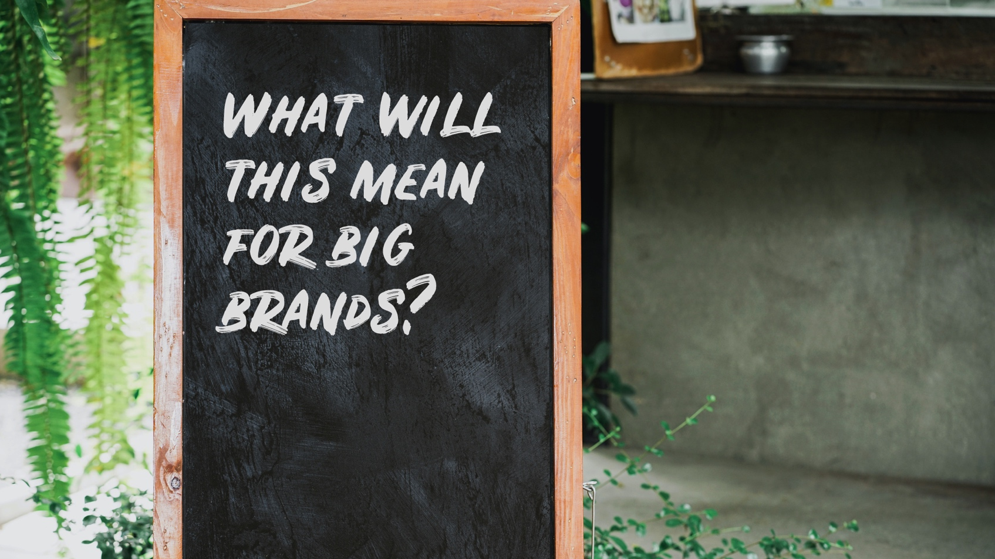

Slide 53

Regionally focused plays
Take advantage of states and provinces that are ready

Slide 54

Firmographics will play a big role
Older and larger businesses will see opportunities a lot earlier than younger and smaller

Slide 55
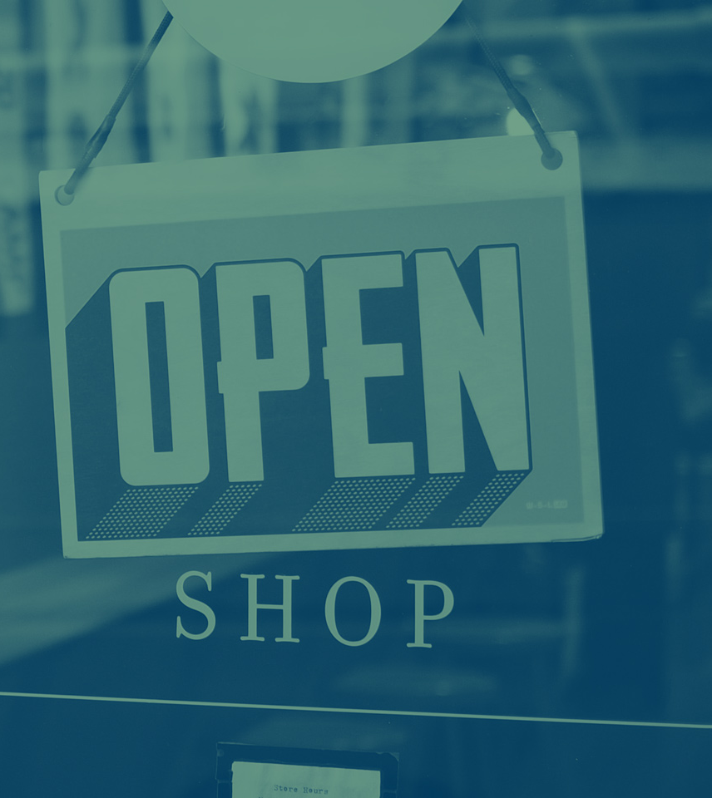
Focus on the industries with “low touch” environments first
Then move on to “medium” and “high-touch”

Slide 56

4 CHALLENGES FOR BUSINESS OWNERS
ALONG THE WAY

Slide 57

1
The Changing
Consumer Behaviors

Slide 58
Digitize Everything
“People are being forced to work from
home, but their whole life is being forced
to adapt digitally.”
Joe McDonnell, WGSN Insight

Slide 59
Cautiousness Reigns
“Even if things were to rebound 100%,
you can’t live through something like this
and not remember it.”
Devon Powers, Ph.D.

Slide 60
The No-touch/Low-touch Economy
“At times of crisis like this, we see
innovation flourish…contactless solutions
may increasingly replace what used to be
high-touch activities.”
Piers Fawkes, PSFK

Slide 61

2
The Financial Impact on Recovery

Slide 62

Lots of public and private money was invested in SMBs during the shutdown.
Support during recovery will be more challenging.

Slide 63

Accessing Capital and Lending
57% of business owners say they need up to $100,000 to keep their businesses running for another 12 months.
That’s $3 trillion.

Slide 64
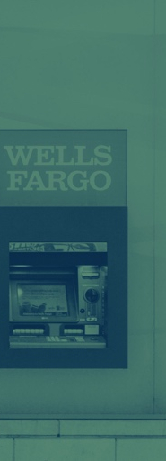
Banks, VC Funds and other go-to financial resources for SMBs are expected to be more cautious.

Slide 65
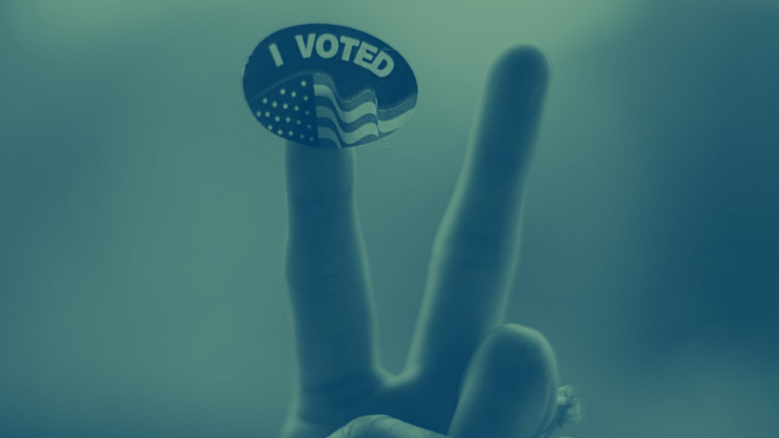
3
The 2020 Election
(as if 2020 wasn’t volatile enough)

Slide 66

90% of SBOs are paying attention to the 2020 election.
(Gallup Poll, February 2020)

Slide 67

Where a Republican President May Help SMBs More
Taxes
Immigration & Tariffs
Government Regulations?
Where a Democrat President May Help SMBs More
Healthcare
Climate Change
Government Regulations?

Slide 68

4
WFH + Workstyles Impact on SMBs

Slide 69
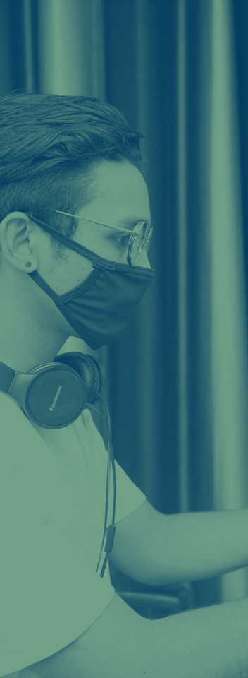
Workstyles, workplaces and work processes may impact what’s next and what’s new even more than consumer behaviors.

Slide 70
Industrial Revolution 4.0
“We stand on the brink of a technological
revolution that will fundamentally alter the way
we live, work, and relate to one another. In its
scale, scope, and complexity, the transformation
will be unlike anything humankind has
experienced before.”
Klaus Schwab, Founder, World Economic Forum

Slide 71

So, how do these influences affect what you do?

Slide 72
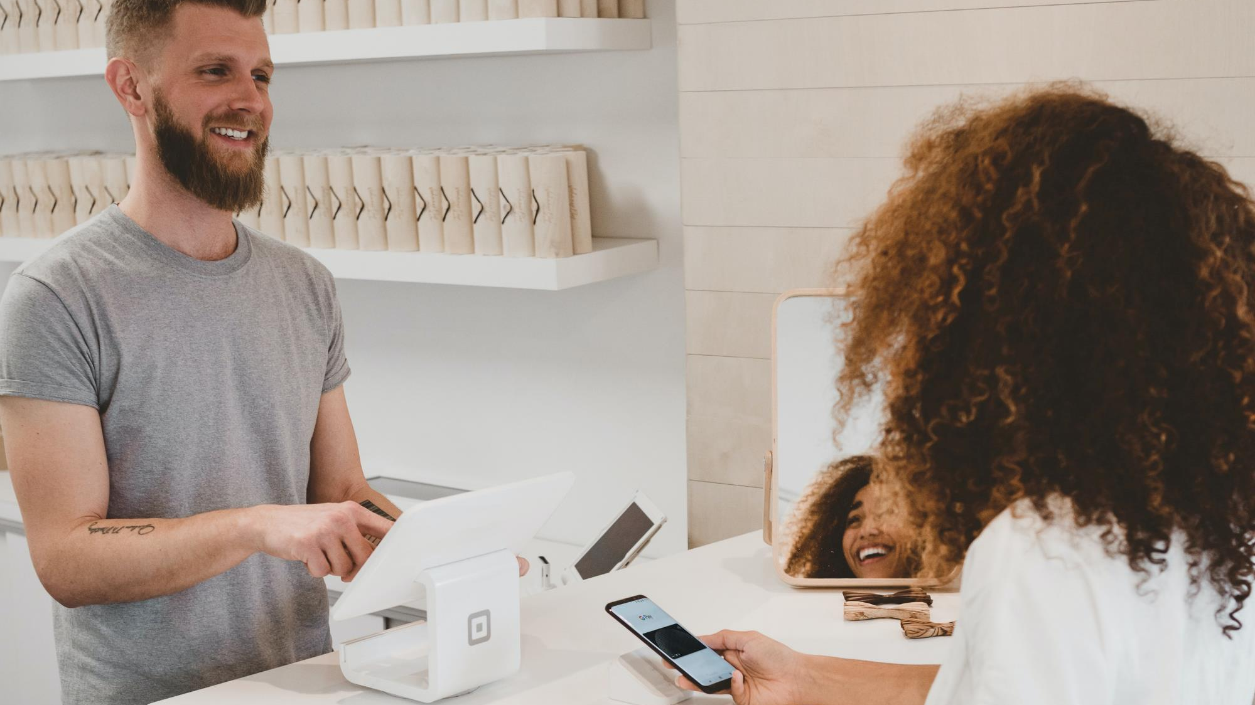
Experiences matter more

Slide 73

For Big Brands
Having the best experiences will win out over the best products and services

Slide 74
For Customers
Connecting more and needing more personal service
For Big Brands
Having the best experiences will win out over the best products and services

Slide 75
For Employees
Living their best life and having more work/life balance
For Customers
Connecting more and needing more personal service
For Big Brands
Having the best experiences will win out over the best products and services

Slide 76

Innovate or Die

Slide 77
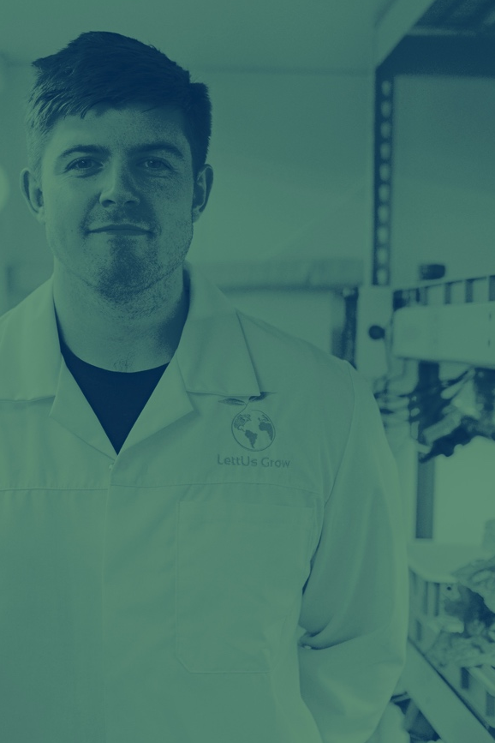
Big Brands can help with innovative ways to solve old, existing or yet-to-be discovered problems and opportunities.
Basically, think and behave like an entrepreneur.

Slide 78
Where to Start Thinking?

Slide 79
Transformative Times = Transformative Strategies
Messaging Strategy: positive, partnering, pioneering
Targeting Strategy: micro vs macro
Brand Strategy: do well while doing good
Content Strategy: digitization, pivoting, WFH support
Retention Strategy: focused, collaborative, cover 1 - 4

Slide 80

This is just the beginning.
More to come soon.

Slide 81
Appendix: More Thinking

Slide 82


Slide 83







POWERED BY

Slide 84
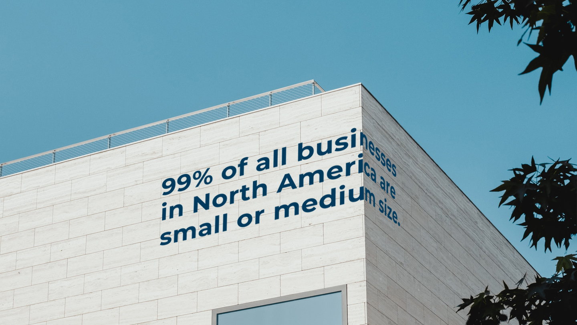

Slide 85

When disaster strikes, how do they recover, get back to work, and pick up the pieces?

Slide 86


Slide 87

What is Project 99?

Slide 88

Project 99 is HQ for
financial aid programs, professional guidance, peer support, and mental wellbeing resources
for small- and medium-sized businesses in the US and Canada.

Slide 89
Project 99 is HQ for
insights, go-to-market strategies & in-market ideas
to help engage, motivate, and retain small- and medium-sized business customers during their recovery and growth.

Slide 90

The two major changes will re-invent the North American SMB.
And big brands will need help marketing to them.

Slide 91

1
Consumer shifts that will influence SMBs

Slide 92

2
Post-pandemic businesses prepared for the next crisis

Slide 93
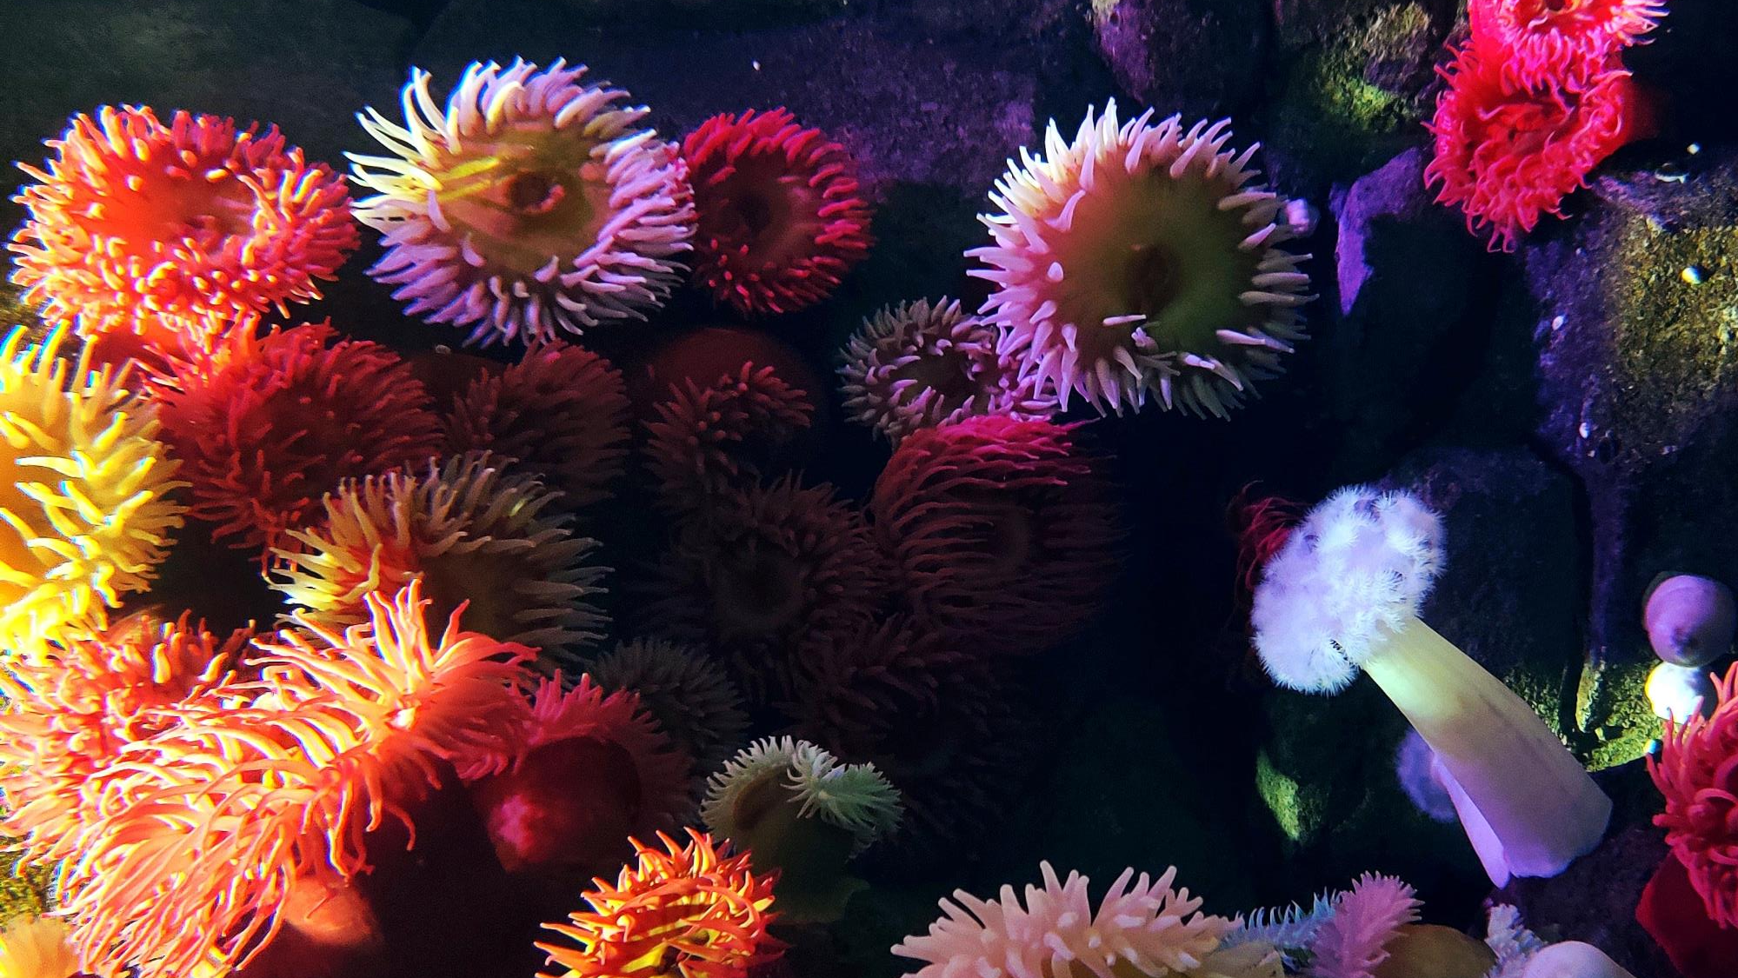
The New Normal Strange

Slide 94
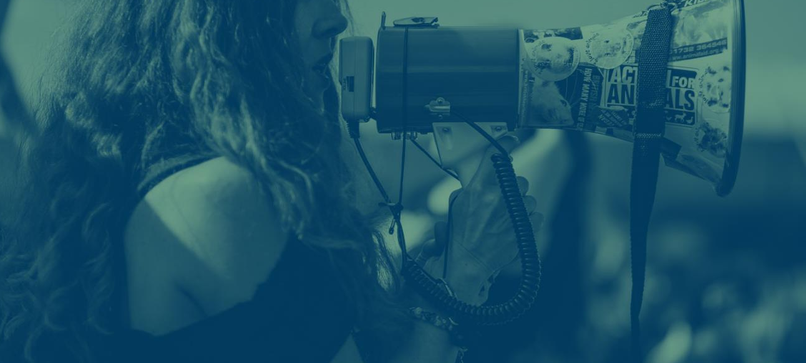
Crisis will always drive change.
Crisis will always get us to
move a lot quicker.
Crisis will always accelerate
the innovation curve.

Slide 95
Small, nimble teams built in a hurry to deal with the COVID-19 emergency made important decisions faster and better. This will be the new recipe for the future.

Slide 96
Preference for local over global products and services.
Need for resilience across supply chains closer to end markets.

Slide 97

A move from the shareholder-focused organization to a stakeholder-focused one.
It’s about balance. It’s about doing good.

Slide 98

New business opportunities will be generated.
New areas of opportunity will be realized.

