Slide 1

Reuniting with the X:
How to Deliver a Winning Experience
Across Channels and Constituencies

Slide 2

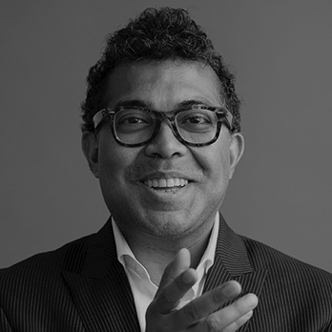

Who we are
Partner, Head of Experience Design
Phase 5
Director of Digital Experience
LSEG

Slide 3
Phase 5 – LSEG
Studies we are drawing upon
3
LSEG
FTSE Russell
Market Assessment | Competitive Landscape
LCH
Product and Solution Innovation
London Stock Exchange
User Experience – ongoing research
Refinitiv
Customer Experience – special analyses to support tracking
23,000 people operating
in 70 countries
Employee experience – foundational international study after COVID – 19
Serve 40,000 customers
across over 190 countries

Slide 4

“
With LSEG’s unique positioning across the whole financial markets value chain, and our leadership role in enabling sustainable economic growth, we now provide a compelling
proposition for all our stakeholders.
- David Schwimmer Chief Executive Officer*
* LSEG Annual Report 2021

Slide 5
Whose X are we talking about?
(When we talk about X at LSEG)
Interest
&
Exposure
All 30 of the world’s largest banks by assets use LSEG data
All 10 of the world’s largest asset managers by AUM use LSEG data **
Evaluate
Capital formation
& issuance
Pre-trade & liquidity discovery
Trade execution
Post-trade & capital optimisation
Purchase
Capital markets
Data & Analytics
Capital Markets
Post Trade
Customers inhabit a wide range of job functions – from strategy and governance to investing
Some use one-off products, others have a daily relationship with our solutions
Our employees are users of our services – directly (e.g., MyRefinitiv) and indirectly, as consumers of financial and media services
A customer might be an individual and an organization – and there might be discrete interactions at different points of the customer journey between LSEG and separate individuals from the same organization (e.g., someone from Strategic Sourcing, and someone from the Trading desk) who do not share their experience with each other
Customer Journey
Usage
&
Support
** LSEG Annual Report 2021

Slide 6
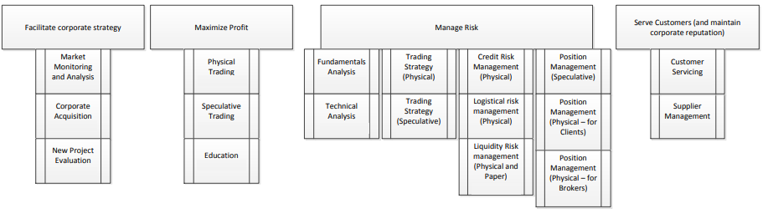
Let us focus on a key target audience:
Commodities Traders
Strategic Objectivities and Attendant activities
… and zero
in on one particularly important activity:
Fundamentals Analysis

Slide 7
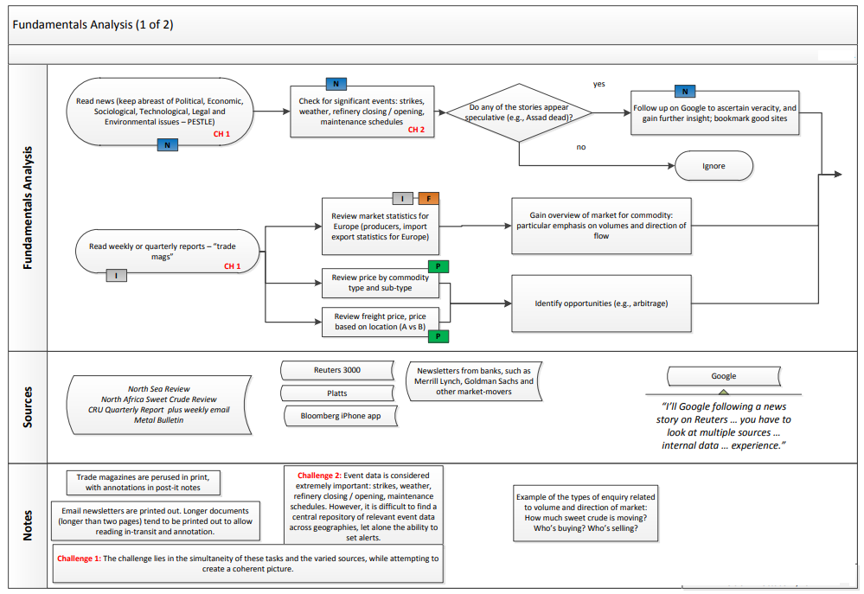
Fundamentals Analysis:
Workflow and challenges (1/2)
Key challenge 1
1
Simultaneity of tasks and varied sources while trying to create a coherent picture
Event data is considered extremely important: strikes, weather, refinery closing / opening, maintenance schedules. However, it is difficult to find a central repository of relevant event data across geographies, let alone the ability to set alerts
2

Slide 8
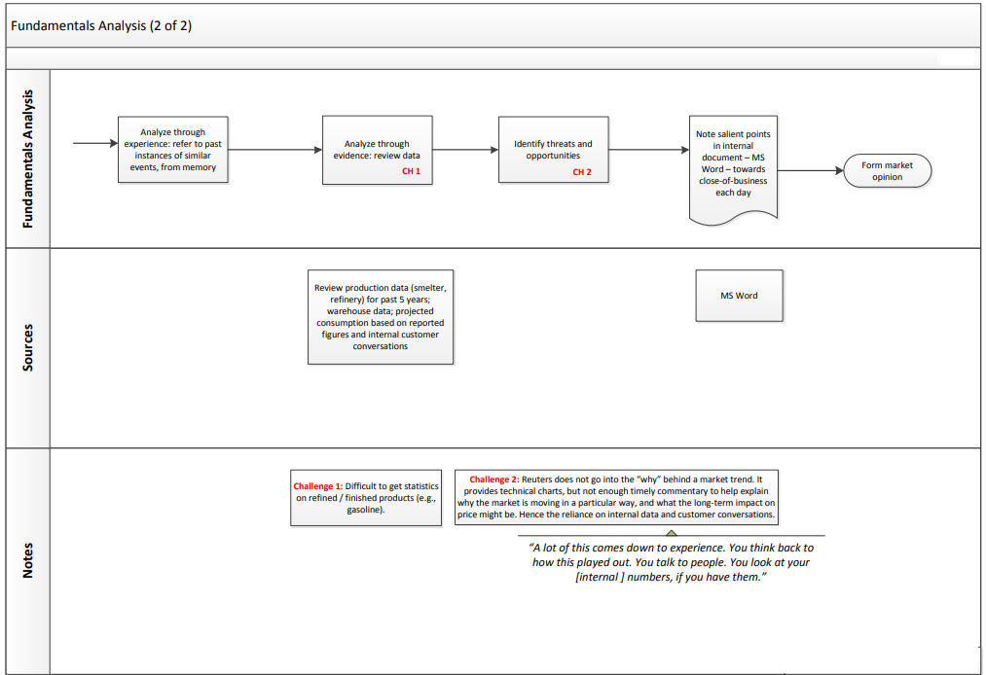
Fundamentals Analysis:
Workflow and challenges (2/2)
Key challenges
1
Difficult to get statistics on
refined / finished products (e.g., gasoline).
Market data tool does not go into the “why” behind a market trend. It provides technical charts, but not enough timely commentary to help explain why the market is moving in a particular way, and what the long-term impact on price might be. Hence the reliance on internal data and customer conversations.
2

Slide 9
A winning experience to meet challenges
Two of the four key challenges identified in the workflow analysis …
Building blocks of
Experience
Simultaneity of tasks and varied sources while trying to create a coherent picture
Difficult to get statistics on refined / finished products (e.g., gasoline).
Strategy
Scope of data to be made available | Commercials | Licensing and usage issues | Compliance | Support (data points from multiple sources might appear to be different, if derived using different parameters, e.g., different values for moving averages)
Common interface for end user and LSEG support (where warranted); Ability to convert each “Support” instance into a learning experience so that end-users leave the session with a fuller understanding of: scope | methodology | functionality | limitations (where warranted)
Scope
Range of data: news, conference call transcripts, weather, shipping, labour news / strike action, regulatory news, commentary
Identification of what is actually relevant to the user’s immediate needs – based on behaviour, usage patterns, as well as covenants and contracts
Familiarizing customer support with full range of what LSEG, and a particular customer, has access to
Structure
Ability to link to multiple databases and draw relevant information – both quantitative and natural language data (structured for cross-reference and access)
Using appropriate tagging to structure natural language data
Training customer support on tagging and full scope of data available
Linking across multiple data sources – internal and external
Linking customer support to info re: internal data (date, sources, assumptions, gaps, etc.) – could be the same as the customer-facing solution, which converts a “help” session into “training”
Skeleton
Visual affordances to inform user of contextual availability of multiple sources
Using UX protocols consistent with other peer offerings
Using anticipatory UX to call user’s attention to contextual info | training customer support
Differentiating between LSEG and non-LSEG data – within an LSEG CX framework
Providing appropriate customer support (e.g., on methodology questions) on LSEG data, and language for handling requests about non-LSEG data
Surface
Coherent display of information from multiple sources from single point on interface in a way that aids insight
Contextual, from chart, with attendant editorial functionality (e.g., export)
Showcasing links to wide range of sources – including external to LSEG
Access to methodology notes, where warranted – for both Employees and End Users

Slide 10

“
Why is this important? In recent years, our customers have seen working patterns change dramatically, accelerating the use of new technologies that improve how quickly and how efficiently they can operate. Customers are looking for fewer but deeper relationships with suppliers to reduce complexity and cost. By offering the data and solutions our customers need, at scale and across a range of distribution methods (desktop, cloud, direct data feeds), customers increasingly turn to us when accessing financial markets.*
* LSEG Annual Report 2021
* LSEG Annual Report 2021

Slide 11
A few initiatives to reunite with the X
UX
Efficiency
Discoverability
Memorability
Accessibility
Consolidation of technical stack
Self-serve portal – e.g., MyRefinitiv – used by both customers and employees
(to help customers)
Anticipatory interface
Knowledge of end-user (which propels anticipatory interface) adumbrates offline customer interactions
Converting “help” and “support” moments into “learning experiences”:
Aids customer’s discovery of further features
Reduces employee / support burden over time and shifts conversation to higher value
User-centric design to aid memorability
Memory aids: cheat sheets | bite-sized videos | webinars – served up contextually as Related Links
Creating flows that are so intuitive that users do not need to consciously remember the steps – one only recalls the overall experience
Anticipating where and how the user will need to access data: devices | locations | limitations (screen size, number of monitors)
Enabling some functionality in the Cloud to enable quick derivation of insight / hypotheses
Inclusivity and local language:
Which languages to prioritize
Which materials to translate
Cultural sensitivities
CX
EX
Forge UI Design System

Slide 12

Employee Experience:
What the global family told us
We want the physical office to be a dynamic healthy space we seek with purpose to solve problems and see challenges through new perspectives
We wish to safely rekindle our personal connections and sense of belonging
We wish to have the right supports in the right place to help us grow and flourish
We wish to have seamless infrastructure and support experiences – regardless of the setting
We wish to optimize the efficiency of interactions with our customers operating in a digital landscape

Slide 13
UX and CX: Convergent Worlds
Efficiency
Discoverability
Memorability
Accessibility
The user’s ability to conduct tasks quickly and with ease using an interface.
The user’s willingness to explore and ability to discover the substantive and functional scope
and idiom of the application.
The user’s ability to remember the substantive and functional scope and idiom of the application.
The user’s ability to interact with
the application through an interface that allows the maximum number of users to access the application unimpeded, and for users with non-normative needs to use assistive technologies to access the full substantive and functional scope of the application.
UX Traditional
The application’s ability to anticipate the customer's need(s) and conduct the task with minimal or no prompting from the user.
The application’s ability to identify the appropriate individual (say, among a household or other group) and surface the most relevant content, functionality (or go passive).
The application’s ability to learn from the customer, and present them with anticipatory suggestions
and prompts – the cognitive load shifts from user to application.
The application’s ability to accommodate users with long- term or situational impediments by minimizing formal input / output requirements – e.g., voice-based commands gained traction in the accessibility context prior to mainstream applications.
UX
Future
Interfaces

Slide 14

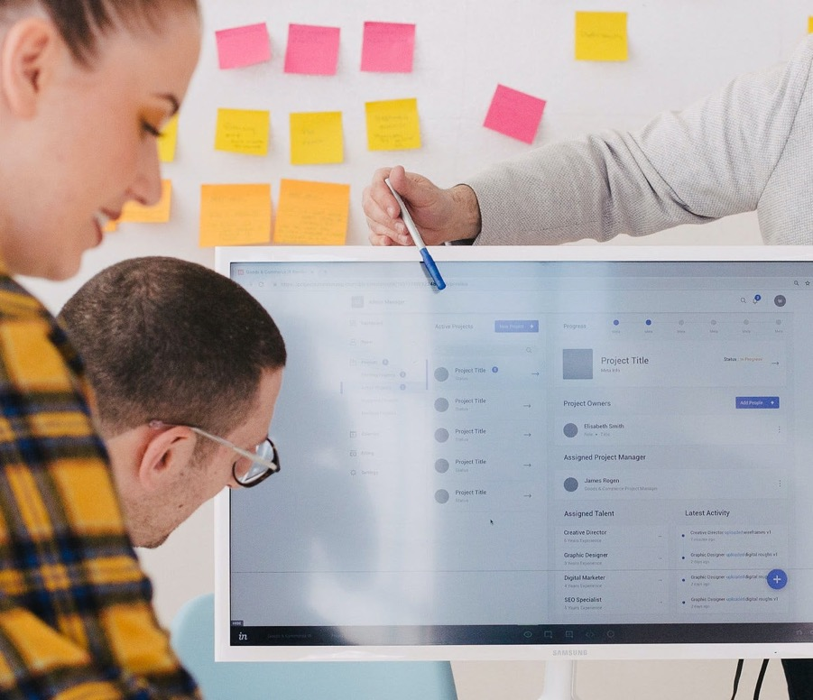
  In conclusion …
User experience focuses on
the individual’s interactions
with a particular
product I service I channel.
The focus is on the human
User’s ability to adapt to a
machine I computer’s needs –
in other words, the human is
reduced to “user.”
Customer experience focuses
on the individual’s interactions
with a particular brand and on
the aggregate experience.
The focus is on the human's
needs – in other words, the
human is no longer reduced to
“user” but is considered in toto.

Slide 15



Thank you!
For questions or comments
Please contact:
Arnie Guha
Partner
arnieg@phase-5.com
Stephan Sigaud
EVP Marketing
stephans@phase-5.com

